Slide 1
Potential Anti-Anxiety Effect of Mucuna pruriens in Experimental Model of Swiss Albino Mice
Anjula Sachan, Sarvesh Kumar, Hemant Singh, Pratap Shankar, Dheeraj Kumar, Amod Kumar Sachan, Rakesh Kumar Dixit

Slide 2
The usage of benzodiazepines, the major class of anxiolytic drugs is invariably accompanied by many side-effects like sedation and muscle relaxation leading to incoordination of movements. Search for novel anxiolytic agents have identified flavonoids as potential compounds devoid of these adverse effects. Mucuna pruriens commonly known as cowhage plant has been claimed to possess various beneficial effects like anti-parkinsonian, anti-tumor, neuroprotective, antioxidant, anti-diabetic and antimicrobial activities. Previous studies have reported that Mucuna pruriens contains LDOPA and 5-hydroxy tryptophan (5-HT) as a major constituent with higher concentration in seeds.

Slide 3
Present study was designed to evaluate the anxiolytic activity of Mucuna pruriens extract in Swiss albino mice. The study was conducted on 30 male Swiss albino mice. Three doses of Mucuna pruriens (100, 200, 400 mg/kg, p.o.) and standard dose of diazepam (2 mg/kg, i.p.) were used for treatment. The pharmacologically validated model elevated plus maze (EPM) was used to take as a measure of antianxiety effect. Mucuna pruriens at the doses of 200 mg/kg and 400 mg/kg significantly reduced the time spent and no. of entries in closed arm, increased the time spent and entries into open arm in elevated plus maze (p<0.05) as compared to control group. Present study demonstrates the anxiolytic activity of Mucuna pruriens in Swiss albino mice.

Slide 4
KEYWORDS
Anxiolytic,
Diazepam,
Elevated plus maze,
Mucuna pruriens,
Side effects,
Swiss Albino Mice.

Slide 5
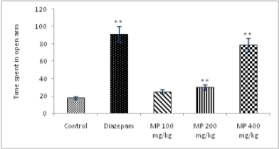
Figure 1: Effect of Mucuna pruriens (MP) and Diazepam (2 mg/kg) in EPM.

Slide 6
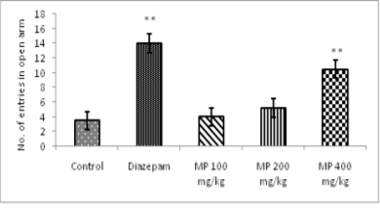
Figure 2: Effect of Mucuna pruriens (MP) and Diazepam (2 mg/kg) in EPM.

Slide 7
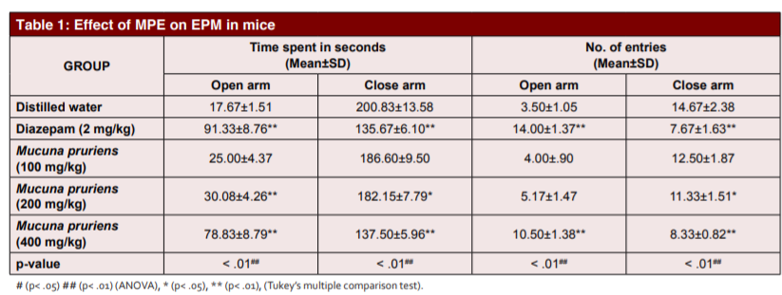

Slide 8
Due to wide benefits of the traditional Indian medicine to the mankind, many studies have shown the importance of the Mucuna pruriens. The Phytochemical screening of Mucuna pruriens confirms the presence of flavonoids and their antianxiety effects. Here we hypothesize that flavonoids present in the extracts of Mucuna pruriens may have acted through benzodiazepine GABA chloride channel receptors. However further studies are needed to know the exact mechanism responsible for antianxiety activity.

