Slide 1
New Age Antipsychotic: Iloperidone
Arpit Navinchandra Shah, Jaykumar Jashvantrai Sejpal, Jigar Ravindrabhai Katwala, Anil Jagdish Jaiswal, Azadar Husain Khan

Slide 2
Schizophreniais a heterogeneous, chronic, severe, and disabling brain disorder that has affected people throughout history. Schizophrenia is a severely debilitating psychiatric disorder observed worldwide, with a median lifetime prevalence of 0.7%–1.0%. Iloperidone possesses stronger affinity for serotonin (5- HT2A) than dopamine (D2) receptors, and its efficacy is roughly comparable to that of other (nonclozapine) antipsychotics. In May 2009, the Food and Drug Administration approved iloperidone for the acute treatment of schizophrenia in adults. Iloperidone may be a useful and safe option for the treatment of schizophrenia. Several confirmatory trials of iloperidone reported to reduced the symptoms of schizophrenia at oral doses from 12 to 24 mg, which was more effective than placebo in reducing positive and negative syndrome total score and Brief Psychiatric Rating scale scores.

Slide 3
Iloperidone was found to be as effective as haloperidol and risperidone in post-hoc analysis. In several clinical studies, most common adverse events reported were dizziness, dry mouth, dyspepsia and somnolence, with few extra pyramidal symptoms and metabolic changes in short and long-term studies in adults. As per adverse effect concern, akathisia was rare in case of iloperidone but prolongation of the corrected QT (QTc) interval was comparable to haloperidol and ziprasidone. Further comparative studies are needed to assess the benefit/risk profile of iloperidone and its role in the treatment of schizophrenia.

Slide 4
KEYWORDS
Antipsychotics,
Dopamine (D2) receptors,
Schizophrenia,
Serotonin (5-HT2A).

Slide 5
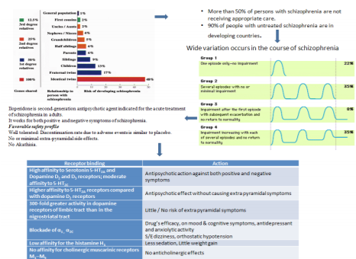

Slide 6
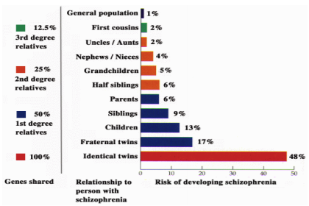
Figure 1: The average risks for developing schizophrenia for different groups of people

Slide 7
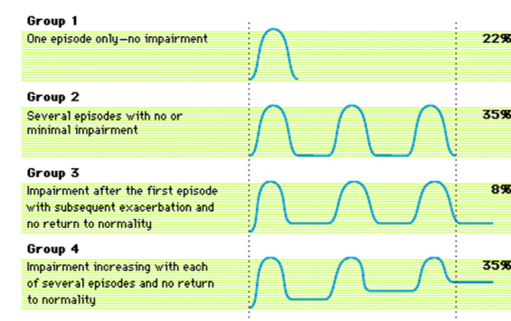
Figure 2: Different courses of Schizophrenia

Slide 8
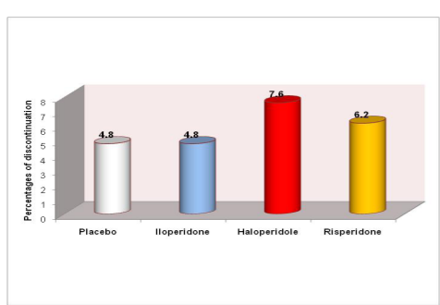
Figure 3: Discontinuation due to Adverse Events (AEs) in groups receiving placebo, iloperdone, haloeridole and risperidone in short-term phase III studies.

Slide 9
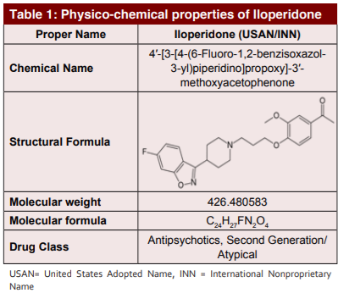

Slide 10
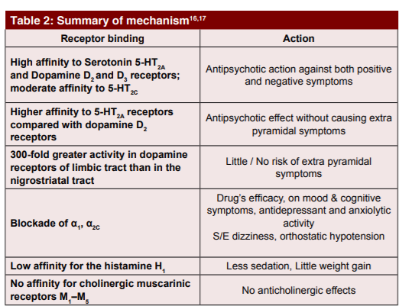

Slide 11
Iloperidone is second-generation antipsychotic agent indicated for the acute treatment of schizophrenia in adults.
It works for both positive and negative symptoms of schizophrenia.

