Slide 1
Gastroprotective and antisecretory properties of methanolic extract of Trianthema portulacastrum. L in aspirin & pyloric ligature induced gastric ulcer in rats
Ramakrishnan Prakash

Slide 2
Objective: The present study was carried out to investigate antiulcer activity of methanolic extract of whole plant of Trianthema portulacastrum L. belonging to the family of Aizoaceae in pylorus ligated and aspirin induced gastric ulcer in rats.
Methods: Preliminary methanol extract of Trianthema portulacastrum L. (METP) was subjected to the acute oral toxicity study according to the OECD guideline no. 425. Based on which, two dose levels i.e. 250 and 500 mg/kg were selected for the further study. In both models, we assessed ulcer index, gastric juice volume, gastric pH and total acidity. Ranitidine (50 mg/kg) was used as the positive control.

Slide 3
Results: : In present study, METP showed significantly decrease in ulcer index in both ulcer models in a dose dependent manner. METP showed a dose dependent significant decrease in gastric juice and total acidity in both the models. A dose dependent increase in gastric pH and total adherent gastric mucus was also produced in METP treated groups.
Conclusion: The present study suggested that the antiulcer activity of METP on pylorus ligation induced gastric ulcer can due to anti secretory activity. The mechanism of protection against aspirin induced gastric ulcer can be attributed to 5- lipoxygenase pathway.

Slide 4
KEYWORDS
Aspirin,
Gastric ulcer,
Pylorus ligated,
Trianthema portulacastrum,
Ulcer index.

Slide 5
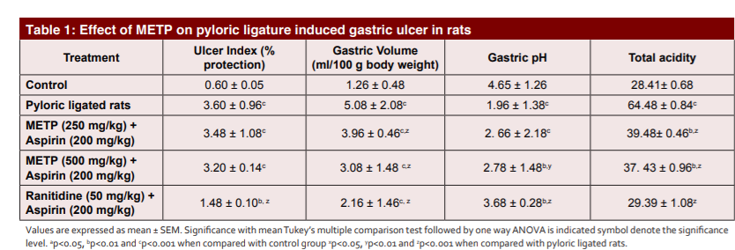

Slide 6
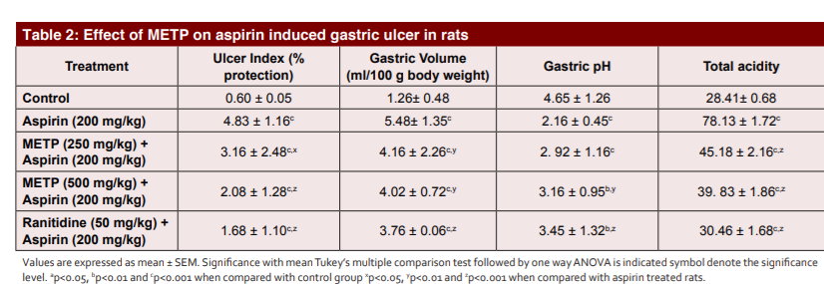

Slide 7
The present study suggested that the antiulcer activity of METP on pylorus ligation induced gastric ulcer can due to antisecretory activity. The mechanism of protection against aspirin induced gastric ulcer can be attributed to 5-lipoxygenase pathway.

