Slide 1
An Overview of Diabetic Nephropathy
Rajavel Varatharajan, Jaganathan Saravanan, Ivy Chung, Nor Azizan Abdullah

Slide 2
Diabetic nephropathy is one of the common complications of diabetes mellitus that has become the leading cause of end stage renal failure in many developed countries. In general, 1 of 3 diabetic patients is developing diabetic nephropathy. High blood pressure, high cholesterol and smoking are increasing the risk of development of diabetic nephropathy. Many factors involving in the development of diabetic nephropathy, which includes oxidative stress and non-enzymatic sources of oxidative stress. In early stage, diabetic nephropathy has no symptoms and it make take 5-10 years to appear the kidney damage begins. Glomerular basement membrane thickening and mesangial expansion are the main morphological features of the diabetic nephropathy. This can be treated or modified with angiotensin converting enzyme inhibitors, angiotensin II receptor antagonists and antioxidants. The main objective of this review is to discuss about the pathogenesis and pharmacotherapy of diabetic nephropathy.

Slide 3
KEYWORDS
Angiotensin-Converting Enzyme Inhibitors,
Antioxidants,
Diabetic nephropathy,
NADPH oxidase,
Oxidative stress.

Slide 4
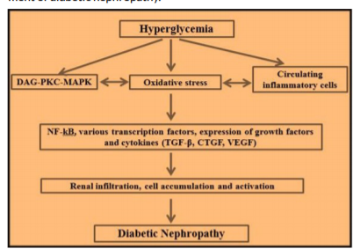
Figure 1: The induction and progression of diabetic nephropathy

Slide 5
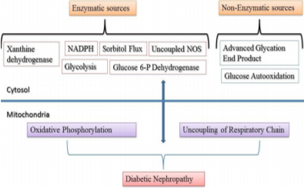
Figure 2: Cytosolic and Mitochondrial sources of ROS implicated in the pathogenesis of DN

Slide 6
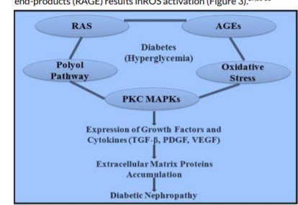
Figure 3: Biochemical hypothesis for diabetic nephropathy

Slide 7
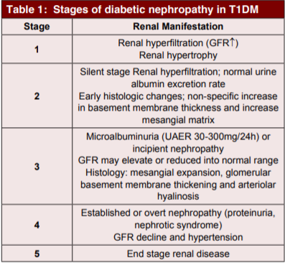

Slide 8
In the last few years, enormous progress in the understanding of the risk factors and mechanisms of diabetic nephropathy, the stages of renal involvement in diabetes, and the treatment strategies to prevent the progression of diabetic nephropathy. Early detection of diabetic nephropathy, adoption of multifactorial interventions targeting the main risk factors (hyperglycemia, hypertension, dyslipidemia, and smoking), and use of agents with a reno-protective effect (ACE inhibitors and/or ARBs) do indeed reduce the progression of renal disease. DN remains the leading cause of ESRD in developed countries, and its occurrence seems to be aggregate in the developing countries. The cost of treating this situation, mainly when patients require renal replacement therapy is huge in order to attain the healthy people 2020 goal. Multifactorial tactic directing strict control of blood sugar, lipids and blood pressure and use of ACEIs and ARBs in proteinuric patients will be preferable. Moreover in addition, low cost community-based program to increase physical activity and avoid unhealthy lifestyle. This will leads to decline in the incidence of diabetes in the population.

