Slide 1
Comparative Performance of Four Indian Pharmocognosy Journals
K. K. Mueen Ahmed, Madhu Bansal, B. M. Gupta

Slide 2
The study presents an analysis of articles covered in four pharmacognosy journals during 2010-13 and the citations obtained by these articles during 2010-15. The study developed immediacy index and impact factor, besides identifying high cited articles published in these four journals. The findings revealed that Pharmacognosy Review has performed the best, followed by Pharmacognosy Magazine, Pharmacognosy Research and Pharmacognosy Journal.

Slide 3
KEYWORDS
Pharmacognosy Journals,
India,
Citation analysis,
Performance evaluation,
Scientometrics.

Slide 5
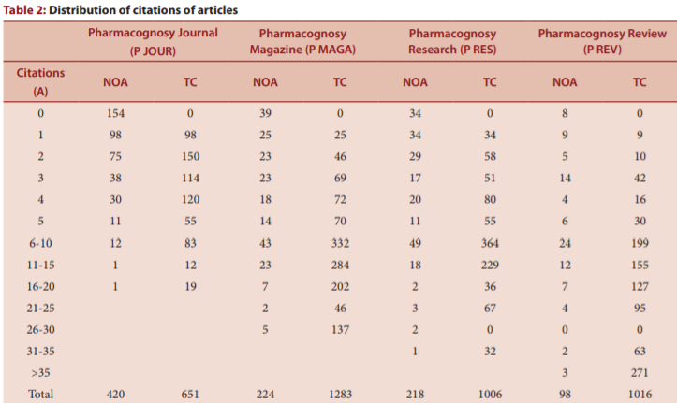

Slide 6
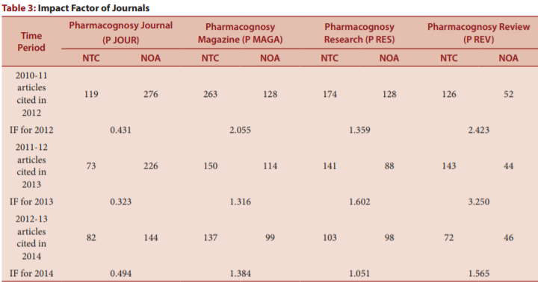

Slide 8
The four pharmacognosy journals under consideration have made importance contribution in field of natural products and pharmacognosy. A comparison of these journals in terms of productivity and citations indices have indicated that Pharmacognosy Reviews has performed the best, followed by Pharmacognosy Magazine, Pharmacognosy Research and Pharmacognosy Journal. Since reviews are expected to get more citations, therefore Pharmacognosy Reviews has performed the best in terms of citation impact indices. But compared to international data, these journals still to achieve a lot in terms of various citation indices. These journals should make efforts to raise their quality by raising their peer review standards and attract contribution by eminent scholars in the field.

