Slide 1
Evaluation of Immunosuppressive Effects of Azathioprine and Cyclophosphamide in CD1® Mice by Flow Cytometer
Mehul Pandya, Darpesh Gohel, Manish V. Patel

Slide 2
Introduction: Qualitative and quantitative analysis of single cells treated with immunomodulators can be done by FACS. T cells, B cells and NK cells, designated as CD cells, are the immunological biomarkers of various haematological conditions which are attributed to prognosis and diagnosis of related disorders. Azathioprine and Cyclophosphamide are immunosuppressive agents, having different mode of action and classification which are been used clinically. Here, we have compared the dose of Azathioprine and Cyclophosphamide in CD-1® mice through lymhocytes’ enumeration by FACS to compare the potency of immunosuppression.

Slide 3
Methods: Randomly divided male and female mice were treated with AZA 20, AZA 50 and CPM 20 for four days, Body weight and feed consumption was taken on day 1 and 5. Collected blood samples were mixed with antibodies. Samples were lysed by lysing solution. Repeated washing and centrifugation yields leucocytes in each tube for estimation. Lymhocytes’ enumeration was performed for CD3, CD4, CD7, CD8, CD16, CD19 and CD45 and percent population of CD markers were evaluated.

Slide 4
Results and Conclusion: All the animals were normal throughout treatment. No significant change in body weight, percent body weight change and food consumption was observed. No gross lesions were observed. Total lymhocytes’ counts were decreased. Double negative tregs of CD4⁻ and CD8⁻ in female mice showed potent immunosuppressive effects and sensitivity towards female gender. Azathioprine was less immunosuppressive than Cyclophosphamide at 20 mg/ kg body weight.

Slide 5
KEYWORDS
CD cells,
Leucocytes,
Fluorescent Activated Cell Sorting System (FACS),
Lymphocyte enumeration,
Immunotoxicity.

Slide 6
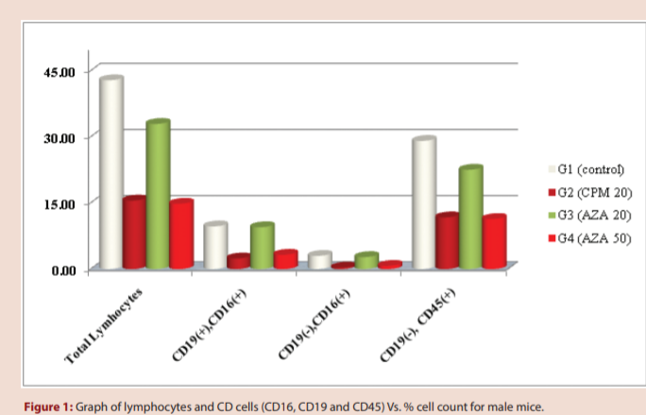

Slide 7
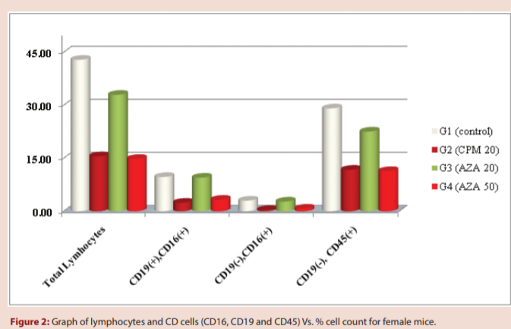

Slide 8
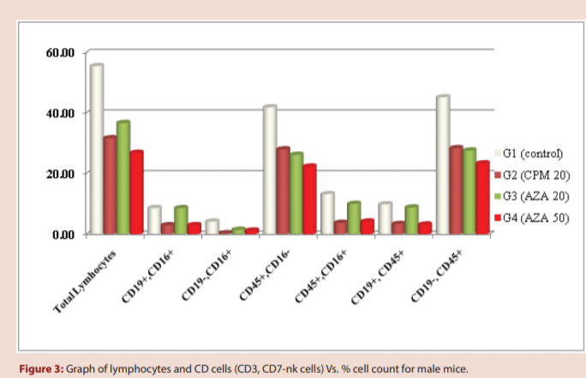

Slide 9
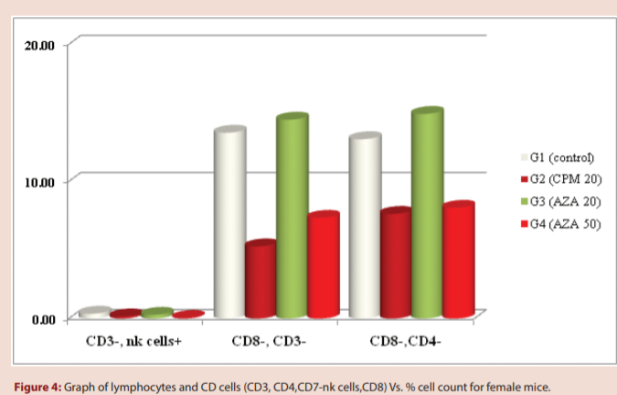

Slide 10
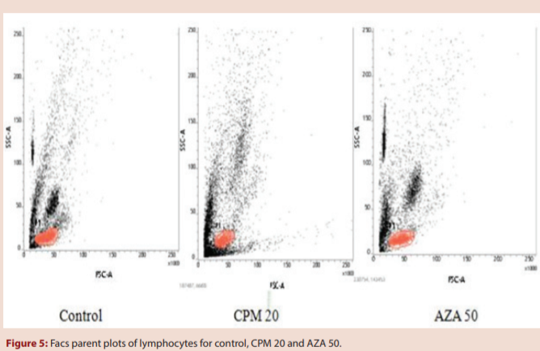

Slide 11
In this experiment, Cyclophophamide at 20 and Azathioprine at 50 mg/ kg body weight have similar immunosuppressive effects on T cells (CD3+, CD4, CD8), B cells (CD19, CD45) and natural killer cells (CD3- , CD16) population in male and female mice.
Female mice could be considered more sensitive than male as both helper and cytotoxic T cells (CD4- and CD8- ) suppressed by Cyclophophamide at 20 and Azathioprine at 50 mg/ kg body weight. This research results can be helpful for comparison in future studies where lymphocytic enumeration is a part of experiment.

