Slide 1
Evaluation of antimutagenic potential of Lagenaria siceraria, Desmodium gangeticum and Leucas aspera
Thakkar Jalaram Hasmukhlal, Santani Dev Das, Patel Chirag Amrutlal, Jani Girish Kantilal

Slide 2
Objective: The aim of the current study was to evaluate antimutagenic (anticlastogenic) activity of methanolic extract of Lagenaria siceraria fruit, Desmodium gangeticum and Leucas aspera.
Methods: The group distribution for animal was, negative control, only extract treated, positive control (cyclophosphamide treated), and two treatment control group for each plant extract. Mutagenicity was induced by administering cyclophosphamide (20-25 mg/kg, i.p) 24 hrs prior to sacrify animals.

Slide 3
Results: The preliminary phytochemical tests showed presence of alkaloids, polyphenols, flavanoids and tannins in alcoholic extract. It’s antioxidant and cytoprotective activity of the extracts has already been reported. On the basis of that we have decided to evaluate its antimutagenic activity in vivo in mice using bone marrow chromosomal aberration assay. Methanolic extract of selected plants had shown significant reduction in percentage of cells with aberration in chromosomal aberration assay. The results obtained by these experiments, strongly suggesting that Lagenaria siceraria fruit extract having potent antimutagenic property than desmodium gangeticum and Leucas aspera. The overall antimutagenic activity of above three extract were in the order of Lagenaria siceraria>Desmodium gangeticum>Leucas aspera. The observed antimutagenic activity of selected plant against Cyclophosphamide might be associated with its antioxidant constituents such as poly-phenolic compound, flavanoids and other micronutrients.

Slide 4
Conclusion: Therefore, from the present study, it can be concluded that methanolic extract of selected indigenous plant extract possesses antimutagenic property.

Slide 5
KEYWORDS
Antimutagenic activity,
Lagenaria siceraria,
Desmodium gangeticum,
Leucas aspera,
Chromosomal aberration assay.

Slide 7
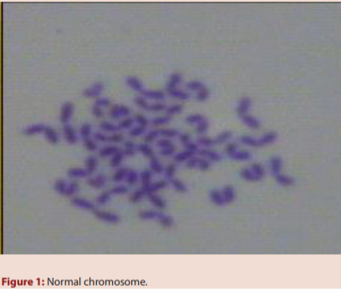

Slide 8
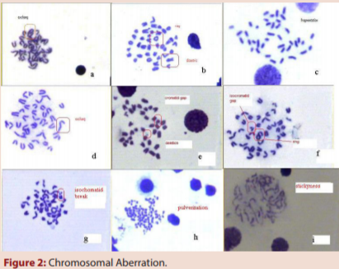

Slide 9
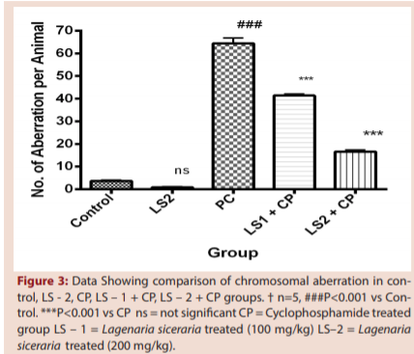

Slide 10
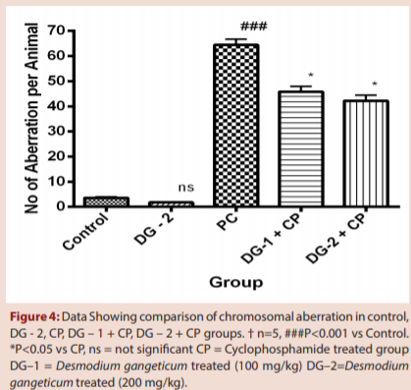

Slide 11
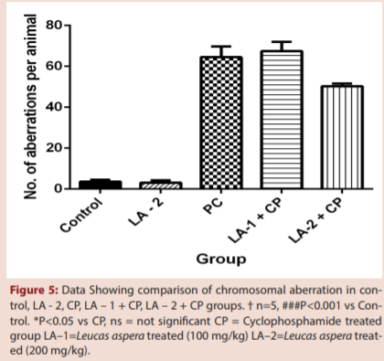

Slide 12
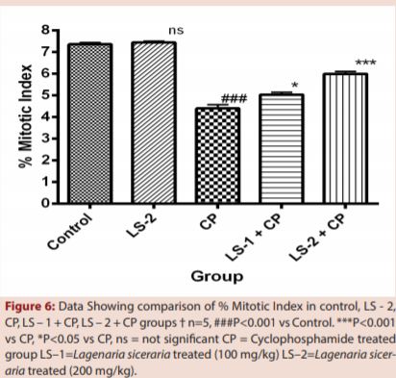

Slide 14
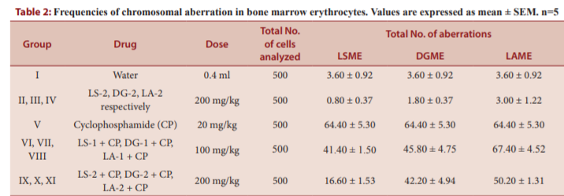

Slide 15
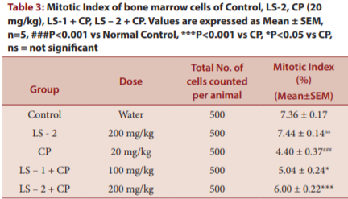

Slide 16
The antigenotoxic effect of methanolic extract of Lagenaria siceraria fruit, Desmodium gangeticum and Leucas aspera arial part was seen against the mutation induced by cyclophosphamide.
As per literature survey antioxidant and cytoprotective activity of Lagenaria siceraria fruit, Desmodium gangeticum and Leucas aspera has been proven. A reason for mutagenic effect is the genotoxicity of reactive oxygen species (ROS) and antioxidants in such cases can act as stabilizers of homeostasis. So there is an increasing interest in the protective biochemical function of natural antioxidants contained in medicinal plants, which prevent oxidative damage caused by oxygen-free radical species. Keeping in mind number of previous investigation about antioxidant and cytoprotective nature of selected indigenous plant extract it can be anticipated that antimutagenic activity observed in the present study may be via antioxidant mechanism.

Slide 17
Therefore, from the present study, it can be concluded that selected indigenous plant methanolic extract possesses antimutagenic property. The observed antimutagenic activity of selected indigenous plant extract against cyclophosphamide might be associated with active compounds and its antioxidant constituents such as poly-phenolic compound, flavanoids and other micronutrients. The significant antimutagenic activity showed by Lagenaria siceraria, Desmodium gangeticum and Leucas aspera provide a scientific validation for the traditional use of these plants. Further investigations will be needed to evaluate the same activity of selected plant extract on other test system as well as to characterize the active compounds in detail.

