Slide 1
Pre-Clinical Toxicological Evaluation of Rostellularia diffusa: Hematological, Biochemical and Histopathological Studies
Mohamed T S Saleem, Chinni Krishnaiah V, Gannepureddy Soumya, Sowjanya Burra, Shaik Abdul Hafeez, Repana Babu, Peddamoyana Rajesh Kumar, Gopinath Chakka

Slide 2
Background: Rostellularia diffusa (Willd.) is a traditional herb belongs to acanthaceae family. The whole plants are used as brain tonic in traditional practice. There were no earlier reports on the safety assessment of Rostellularia diffusa.
Objective: The present study was undertaken to assess the safe use of this plant in traditional practice.
Methods: The acute oral toxicity study of hydro alcoholic extract of Rostellularia diffusa (AERD) was carried out as per the OECD guidelines 423 and the sub-acute toxicity was carried out at a dose of 150 mg/kg and 300 mg/kg as per OECD 407 guidelines in male and female rats.

Slide 3
Results: : Rats were administered up to 2000 mg/kg as a single dose orally not caused any signs of toxicity or mortality in rats. In sub-acute toxicity study in rats, AERD at two different daily doses of 150 and 300 mg/kg for 14 days did not cause any significant change including the hematological and biochemical parameters. Histopathological examinations showed normal architecture suggesting no morphological disturbances.
Conclusion: No deaths or any signs of toxicity was observed after oral administration in acute toxicity study up to a dose of 2000 mg/kg of AERD in rats and up to a dose of 300 mg/kg of AERD in sub-acute toxicity study in rats.

Slide 4
KEYWORDS
Brain tonic,
Toxicity study,
Rostellularia diffusa,
Herbal medicine.

Slide 5
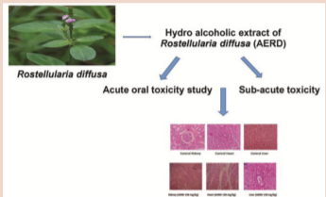

Slide 6
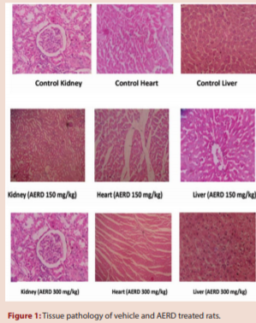

Slide 9
Based on the above findings, it has been concluded that the hydroalcoholic extract of plant Rostellularia diffusa seems to be nontoxic in animal model. Further, chronic toxicity studies want to be conduct to find out the teratogenic and carcinogenic safety profile of this plant.

