Slide 1
Pharmacist Intervention Documentation in Saudi Arabia
Yousef Ahmed Alomi, Ebtissam Mohammad Badawoud,
Asma Al-Dosari, Asmaa Al-Fifi, Razan Al-Dossari,
Haya Fahad bin Omar, Huda Al-Jaziri

Slide 2
Objectives: To explore the pharmacist intervention documentation in the Kingdom of Saudi Arabia.
Methods: This is a 4-month cross-sectional self-administrated survey on documentation of pharmacist intervention. The study consisted of two parts: the first part collected demographic information and the second part comprised of a questionnaire with 18 questions. The second part included policy and procedure, type of data through pharmacist intervention, reporting workload of pharmacist intervention documentation. All types of pharmacist professionals were included in this survey. We used a 5-point Likert response scale system to obtain the responses. There were open- and close-ended questions. The survey was distributed through the social media (WhatsApp) and other social media to more than 1000 pharmacist professionals in the Kingdom of Saudi Arabia. The survey was distributed in an electronic format and the data were analyzed through Survey Monkey system.

Slide 3
Results: A total of 128 pharmacists responded to the survey. Of them, 106 (82.81%) were Saudi and 22 (17.19%) were non-Saudi professionals. The majority of the responders were in the age group of 25–34 years and 35–44 years (44.53% and 25.00%, respectively). Most of the responders had obtained Bachelor of Pharmacy (40 (31.25%)) and Doctor of Pharmacy degree (33 (25.78%)) and the majority of the pharmacists (112 (87.50%)) were not accredited by the Board of Pharmaceutical Specialty. The average score of the administration element of pharmacist intervention documentation was 3.68 (73.66%). Policies and procedures of pharmacist intervention documentation obtained the highest score (4.13 (82.6%)) followed by the quality management (3.78 (75.60%)) and education with training (3.76 (75.20%)). Adverse drug reactions (92.86%) and medication errors (91.19%) were most of the recorded type of documentation and poisoning information inquiries (65.62%) and medication reconciliation (80.31%) were the least type of documentation, with an average 54.66% documented electronically.
Conclusion: The pharmacist intervention documentation was found to be acceptable in the Kingdom of Saudi Arabia. The half of pharmacist intervention documentations was an electronic only. In the future, we recommend to improve the system and correct barriers related issues. This will enhance the process of documentation and explore the impact and role of the pharmacist in the Kingdom of Saudi Arabia.

Slide 4
KEYWORDS
Pharmacist,
Intervention,
Documentation,
Pharmacy,
Workload,
Saudi Arabia.

Slide 5
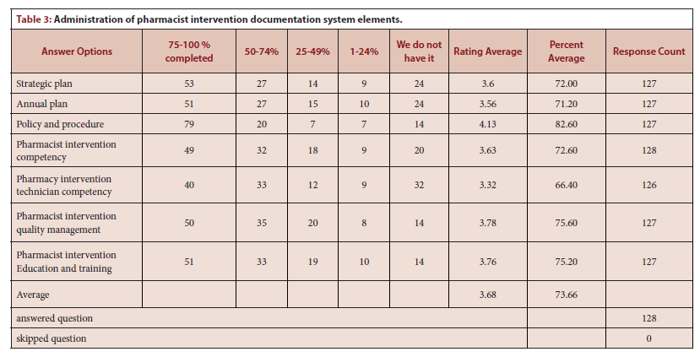

Slide 6
