Slide 1
Privileges of Pharmacists in Saudi Arabia: Drug Monitoring and Providing Education to Healthcare Professionals
Faisal Al-Otaibi, Mohamed Soliman Imam, Randa Mansour Abdel-Sattar Ahmed, Amsha Alotaibi, Asma Alotaibi, Amal Alotaibi, Wesam Alsuwaid, Yousef Ahmed Alomi

Slide 2
Objectives: To explore the privileges of pharmacists with regard to the drug monitoring and providing education to healthcare professionals in Saudi Arabia.
Methods: This is a 4-month cross-sectional sur¬vey regarding drug monitoring and providing education to healthcare professionals in Saudi Arabia. The study consisted of two parts: the first part collected demographic information and the second part com¬prised a questionnaire with 28 questions divided into 4 domains. The questions were derived from pre¬vious literature and from the regulatory standards of the American Society of Health-System Pharma¬cists (ASHP). The four domains were as follows: management and resources, pharmacist prescribing and therapeutic interchange, clinical and administration privilege and drug monitoring and healthcare education. The responses were obtained using a 5-point Likert response scale system with close- and open-ended questions. The survey questionnaire was distributed in an electronic format to the director of pharmacy. In this study, we analyzed pharmacist’s privilege with regard to drug monitoring and the education of healthcare providers. All data were obtained through the Survey Monkey system.

Slide 3
Results: The survey was distributed to 36 hospitals. Most of the pharmacist’s privilege in drug monitoring and documentation of the clinical impact and cost avoidance was related to patient counseling (90.63%), adverse drug reactions (88.24%) and drug quality reporting (87.50%). Most of the candidates were students from Diploma in Pharmacy (50.00%) followed by (47.22%) pharmacy student and (44.44%) pharmacy technician. Majority of the pharmacists having privileges in providing education and training was available for pharmacists and clinical pharmacists. Finally, pharmacy technicians delivered most of the education and training to general physicians, nurses and specialist physicians.
Conclusion: In Saudi Arabia, privileges of a pharmacist with regard to drug monitoring do not exist in various departments of hospitals such as neonates, pediatrics and geriatrics patients. Regular and clinical pharmacists had most of the privileges in providing education and training to the healthcare professionals and few of the healthcare professionals received education and training by the pharmacists. Therefore, there is an increasing demand of a comprehensive awareness program about privileges of a pharmacist in the Kingdom of Saudi Arabia.

Slide 4
KEYWORDS
Privileges,
Pharmacists,
Drug Monitoring
Education,
Healthcare,
Professionals,
Saudi Arabia.

Slide 6
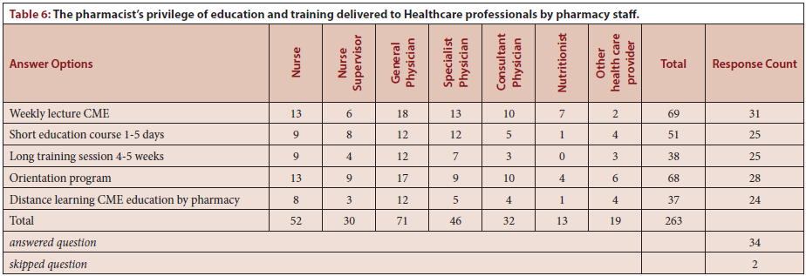

Slide 7
Two-thirds of the privileges of the pharmacist is given to monitoring drug therapy and one-third on education and training in the KSA. Majority of the privilege related to drug therapy monitoring activities were common with few improvements. Further studies should target a comprehensive review of pharmacist’s privilege with regard to drug therapy monitoring and education and training in KSA.

