Slide 1
National Survey of Clinical Pharmacy Practice in Saudi Arabia-2017-2018: Workload Documentation
Yousef Ahmed Alomi, Fatimah Al-Doughan,
Sultan Mohammed Al-Jarallah, Yasir Ahmed Ibrahim,
Adel Mehmas Alragas, Norah Omar Bin Haidarah

Slide 2
Objectives: To explore the workload documentation of clinical pharmacy practice in Saudi Arabia during 2017-2018.
Methods: This is a 4-month cross-sectional national survey regarding the workload docu¬mentation of clinical pharmacy practice in Saudi Arabia. The survey consisted of two parts: The first part collected demographic information and the second part comprised a questionnaire with 51 questions divided into four domains. These domains were derived from the American Society of Health-System Pharmacists (ASHP) and Saudi Pharmaceutical Society (SPS) survey and the International Standard of Joint Commission of Hospital Accreditation in addition to the local standards of Saudi Center of Healthcare Accreditation. The four domains were clinical pharmacy administration and management, performances and activities, education and training and workload documentation. We used 5-point Lik¬ert response scale system with close-ended questions to obtain the responses. The questionnaire was distributed in an electronic format to the 31 directors of pharmacies at hospitals. In this study, we con¬ducted a national survey of clinical pharmacy practice at hospitals in Saudi Arabia on workload analysis and documentation. All data were obtained through the Survey Monkey system.

Slide 3
Results: The survey was distributed to 31 hospitals and the total number of the patients who were followed up through clin¬ical pharmacy services was 27.88 daily, 836.29 monthly, with 10.82 patients daily per hospital. The total number of prescriptions reviewed by the clinical pharmacist was 184.86 daily, 1294.05 monthly, with (68.77) patients daily per each hospital. Most of the documented clinical pharmacy services existed for medication errors (80.65%), adverse drug reactions (77.42%) and drug quality reporting (70.97%). Most of the documentation of clinical impact and cost avoidance of clinical pharmacy services existed for drug information inquiries (61.29%), medication errors (58.06%) and adverse drug reactions (58.06%). Most of the monthly workload analysis of clinical activities existed for the number of prescriptions (80.65%), number of medication errors (70.97%) and for adverse drug reactions (67.74%).
Conclusion: The documentation of workload of clinical pharmacy services is inadequate especially with respect to the clinical outcome and cost avoidance impact. Most of the clinical pharmacy activities were ordinary performances provided to few numbrer of patients. Improve the documentation of workload activities is highly recommended in Saudi Arabia.

Slide 4
KEYWORDS
Clinical,
Pharmacy,
Practice,
Workload,
Documentation,
Saudi Arabia.

Slide 5
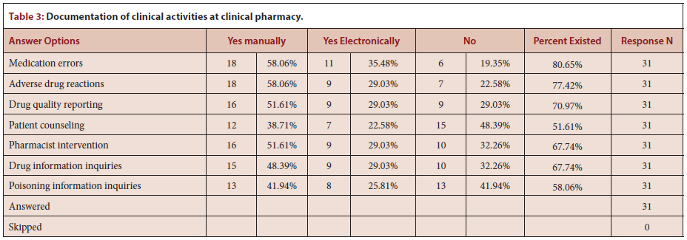

Slide 6
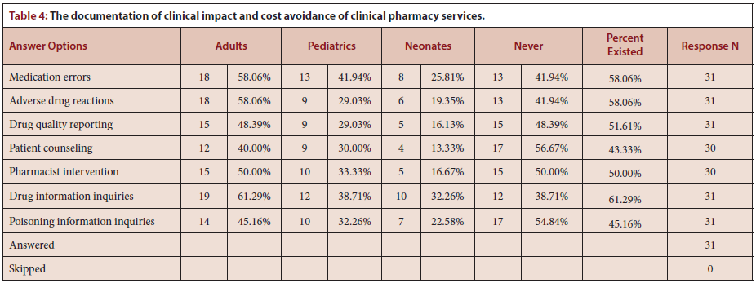

Slide 7
The documentation of workload of clinical pharmacy services was found to be inadequate in this study, especially in the cost avoidance and clini¬cal outcome impact. There is a need to study the factors that can discour¬age pharmacists from documentation in order to improve the workload activities documentation in the KSA in order to benefit from the positiv¬ity of documenting clinical pharmacy services.

