Slide 1
Reliability and Validity of Biostatical Analysis used for Pharmacy Research Questionnaire in Saudi Arabia
Yousef Ahmed Alomi, Ismail Hassan Amer Abu Rayah

Slide 2
Objectives: To declare reliability and validity of Biostatical Analysis used for Pharmacy Research Survey in Saudi Arabia.
Methods: It is a cross-section survey developed by the authors and the research team. It’s based on the updated literature, national and international accreditation standards organiza¬tions. The Internal consistency, reliability through inter-rater reliability, item-item coloration, item-total coloration, Split half reliability (Gutmann’s λ6) and McDonald’s ω, Cronbach alpha. The validity contained of face content validity, construct validity through exploratory factorial analysis and confirmatory factor analysis. All analysis had been done through Statistical Package of Social Sciences (SPSS), Statistical Package of Social Sciences-Analysis of Moment Structures (SPSS-Amos) and Jeffrey’s Amazing Statis¬tics Program (JASP).

Slide 3
Results: A total of 209 pharmacists responded. The majority of responders were Saudi 185 (88.52%). The among responders were males [108 (61.77%)] and females [101 (48.33%)]. The three tests had been done with reliability of 31 questions. The completed responders (185) (mean ± SD) was 3.236 ± 0.326 and McDonald’s ω, Cronbach alpha and Gutmann’s λ6 were 0.980, 0.980 and 0.990, respectively with CI 95% (0.975-0.983) and inter-item coloration was 0.607, while the item-total coloration >0.53 and McDonald’s ω, Cronbach alpha and Gutmann’s λ6 value if deleted was >0.97. By using Exploratory Factor Analysis (EFA), the Kaiser-Meyer-Olkin Measure of sampling adequacy was 0.966 and Bartlett’s test of sphericity with approximate chi-square was <0.001. The commonalities extraction for all questions was >0.57, the related components were four of all 31 questions in four components as suggested. They were not confirmed by confirmatory with statistically significant (p<0.001) of the factor model, by factor analysis, by scree plot and pathway analysis and fit not with the original survey changed to 3 factor loading. The confirmatory factor index was (0.761), Tucker-Lewis Index (TLI) was (0.737), Goodness of fit index (GFI) was (0.844) and expected cross validation index (ECVI) (9.029). The collinearity of 23 questions was autocorrelation (2.609e -5) with not statistically significant (p=0.951). The majority of 23 question had Enjuone value close to number 1, while 11 questions had condition index more than 30. All of the 23 questions had The Variance inflation factor (VIF) less than 10 except four questions and had tolerance more than 0.1 except four questions.
Conclusion: The reliability and validity related to the corrected survey of biostatistics analysts used in pharmaceutical research in the Kingdom of Saudi Arabia were high. The pharmacy practice was properly used in further future research in Saudi Arabia.

Slide 4
KEYWORDS
Reliability,
Validity,
Biostatical Analysis,
Knowledge,
Pharmacy,
Research,
Survey,
Saudi Arabia.

Slide 5
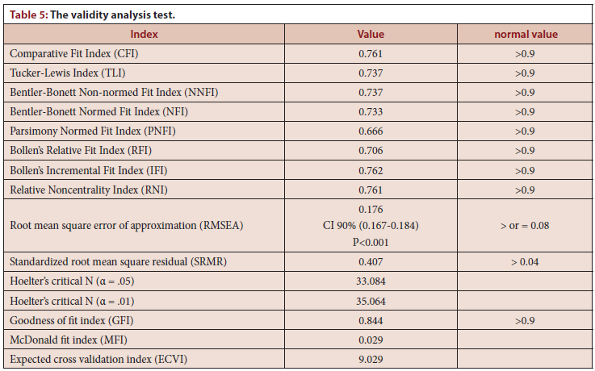

Slide 6
The knowledge of biostatistical analysis was used in pharmacy research with the corrected survey had high reliability and validation scale level. Further study with a corrected survey in the future with an adequate sample size is suggested in the Kingdom of Saudi Arabia.

