Slide 1
Antibiotic Prescribing Pattern at Primary Health Centers in Riyadh City, Saudi Arabia
Zainab Albahooth, Yousef Ahmed Alomi,
Samia Zaben Almurshadi, Hind Nasser Altamimi,
Abdulaziz Hussain Alhussain

Slide 2
Objectives: This study aims to identify antibiotic prescribing patterns in Riyadh’s Primary health care centers (PHCs).
Methods: The study was a one-month cross-sectional medication prescription survey conducted at 25 PHCs in Riyadh.
Results: A total of 18031 prescriptions were recorded in all 25 PHCs during the study period. Antibiotics were present in 3,879 (21.51%) of all prescriptions. The percentage of antibiotics prescribed varied from one primary care center to another; the highest documented percentage was 38.01 %. In comparison, the lowest proportion was discovered to be 10.56% of total antibiotics prescribed, with 3,131 (80.67 %) being bactericidal and 748 (19.3 %) being bacteriostatic. Capsules were the most commonly prescribed antibiotic dosage form 1,240 (32%), Amoxicillin was the antibiotic most frequently prescribed 1628 (42%), followed by a combination of Amoxicillin/Clavulanate 797 (20.5%). Of the total prescriptions, 2931 (75.6%) were written with generic names, while 948 (24.4%) were written with brand (trade) names. Amoxicillin was the most commonly prescribed antibiotic with a generic name (52.7%), while Amoxicillin/Clavulanate was the most usually prescribed antibiotic with the brand name “Augmentin” (69.4%). The frequency of antibiotics prescribed to patients who did not have a documented indication for Amoxicillin was 270. (6.9%).

Slide 3
Conclusion: Antibiotics were prescribed in one-third of PHC prescriptions. Antimicrobial stewardship programs and training for healthcare professionals are needed at PHCs in Riyadh, Saudi Arabia.

Slide 4
KEYWORDS
Antibiotic,
Prescribing,
Pattern,
Primary Health Centers,
Riyadh City,
Saudi Arabia.

Slide 5
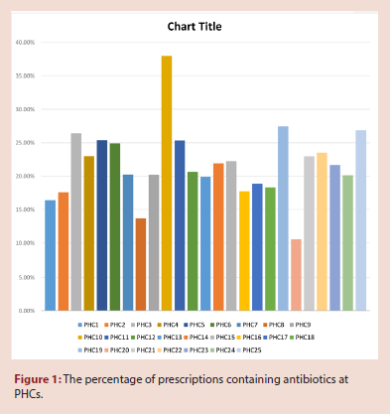

Slide 6
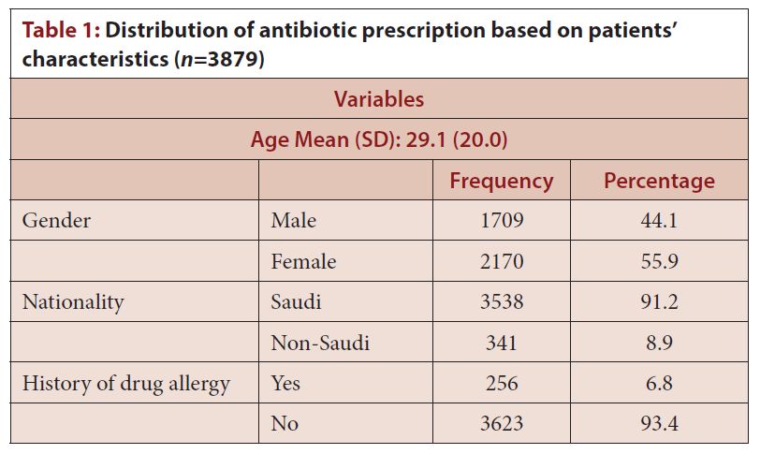

Slide 7
Antimicrobial resistance is caused by unnecessary use, insufficient duration of therapy, inappropriate doses, and irrational fixed-dose drug combinations. As a result, this study was conducted to investigate the pattern of antibiotic prescribing in PHCs. This study provided a good picture of the pattern of antibiotic prescribing in PHCs in KSA, which provided valuable data that could aid in the development of interventions aimed at increasing antibiotic use. However, because the study was conducted in only the capital city of Riyadh and for a short period, it cannot be generalized to the entire country. Furthermore, it implies the long-term need for similar studies in other parts of the country. Nonetheless, this study has far-reaching implications for policy and practice. The findings indicate an urgent need to train prescribers and educate the public to prevent inappropriate antibiotic prescribing and use.

