Slide 1
Public Knowledge of Hand Sanitizers and Disinfectants in Saudi Arabia
Yousef Ahmed Alomi, Basmah Sulimain AlHamdan,
Amani Abdullah Bahdailah, Sahar Obaid Alosaimi,
Deema Abdullah Altuwayhir

Slide 2
Objectives: Hand sanitizers and disinfectants have been commonly used during epidemic and pandemic situations. Despite the proven efficacy and safety of sanitizers and disinfectants, the publics’ knowledge about their use is still controversial. In this survey, we aimed to investigate the knowledge of the public about the use of hand sanitizer and disinfectants in the Kingdom of Saudi Arabia.
Design and Setting: A self-administered structured questionnaire was sent to the public via online mode. It collected demographic information and collected information about different hand sanitizers and disinfectants and their general knowledge on such products, contraindications, and storage information during the COVID-19 pandemic. Data were collected through the Survey monkey program.

Slide 3
Results: A total of 402 participants responded to the questionnaire. Of them, 32.58% were from the western region, and 25.76% were from the central area, and there were statistically significant differences between different regions (p=0.000). Based on nationality, 90.88% of Saudi nationals responded to the questionnaire. In addition, 65.17% of the responders were female, with statistically significant differences (p=0.000). The most prevalent age group was between 18 and 29 years (50.25%), with statistically significant differences between all age groups (p=0.000). The average general knowledge score was 3.90emphasizing the medication administration (4.40) and frequency of usage (4.25). The average score of contraindication knowledge was 2.91. The feature most known by the public was the general side reaction that appears during use (3.21), and usage of the medication with other drugs is forbidden (3.04). The average score for the knowledge of storage was 3.45. The part most known by the patient was the storage of the sanitizer or disinfectant at room temperature (3.91) and sanitizer or disinfectant prices in general (3.58).
Conclusion: The knowledge about storage of sanitizers and disinfectants among the public in Saudi Arabia was satisfactory; however, the knowledge about contraindications was insufficient. Therefore, we recommend increasing the general public’s awareness about sanitizers and disinfectants in the Kingdom of Saudi Arabia.

Slide 4
KEYWORDS
Public,
Knowledge,
Sanitizer,
Disinfectants,
Saudi Arabia.

Slide 5
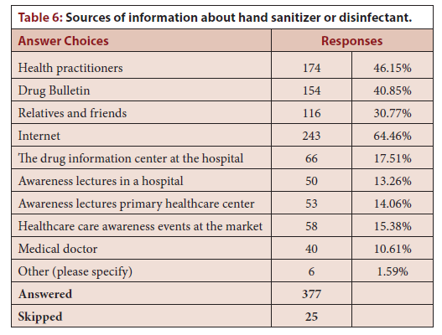

Slide 6
The essential knowledge about sanitizers and disinfectants during the COVID-19 pandemic is acceptable in Saudi Arabia. However, the knowledge of the public about contraindications is inadequate. Most factors such as location, nationality, gender, and occupational status did not affect the understanding of sanitizers and disinfectants. However, healthcare professionals’ age and membership might positively or negatively affect the knowledge of sanitizer and disinfectants. Therefore, we recommend providing educational sessions to the public about sanitizers and disinfectants to improve patient safety effectively.

