Slide 1
Antibiotic Prescribing Pattern: Pharmacy Staff Knowledge about Antibiotics at Primary Health Care Centers in Riyadh City, Saudi Arabia
Zainab Albahouth, Samia zaben Almurshadi, Hind Nasser Altamimi, Tarfah Sultan Binjerais, Abdulaziz Hussain Alhussain, Yousef Ahmed Alomi

Slide 2
Objectives: To declare pharmacy staff knowledge of the rational use of antibiotics at primary health care centers in Riyadh City, Saudi Arabia.
Methods: Self-administered Questionnaires were distributed to fifty-six pharmacy staff (pharmacists and pharmacy technicians) from randomly selected twentyfive primary health care centers in Riyadh City, Saudi Arabia. The questionnaire included demographic information and 14 closed-ended questions about the rational usage of antibiotics.

Slide 3
Results: All the fiftysix pharmacy staff responded to the survey with a response rate of 100%. The responders consisted of having a Diploma in pharmacy (28 (50%)), a Bachelor’s in pharmacy (27 (48.2%)), and one (1.8%) postgraduated pharmacist. Most pharmacy technicians were female, 18 (32.1%) vs. 10 (17.9%) male, with non-statistically significant differences between them (p=0.131), while the pharmacists were female 22 (39.3%) vs. male 5 (8.9%) with statistically significant differences between them (p=0.001). There is insufficient knowledge of the rational use of antibiotics among pharmacy technicians and pharmacists respondents. All pharmacy technicians and pharmacists in the study knew that antibiotics are mainly used for bacterial infections. However, many pharmacy technician and pharmacist participants did not know that antibiotics are ineffective for viral and fungal infections (25% and 14.3% for pharmacy technicians, respectively) vs. (16.1, and 17.9% for pharmacists, respectively). There was no difference in the mean knowledge of antibiotic prescription among respondents, pharmacy technicians, and pharmacists. Furthermore, the respondents had no statistically different knowledge regarding age, gender, and working experience (p>0.05). However, the age factor might play a significant role in antibiotics knowledge for pharmacy technicians only. Conclusion: The primary health care centers Pharmacy staff (pharmacy technicians and pharmacists)’ knowledge of antibiotics rational usages was insufficient. Targeting training and educating about antibiotics generally emphasize antimicrobial resistance risks are highly recommended.

Slide 4
KEYWORDS
Pharmacy,
Knowledge,
Antibiotics,
Primary healthcare center,
Riyadh,
Saudi Arabia.

Slide 5
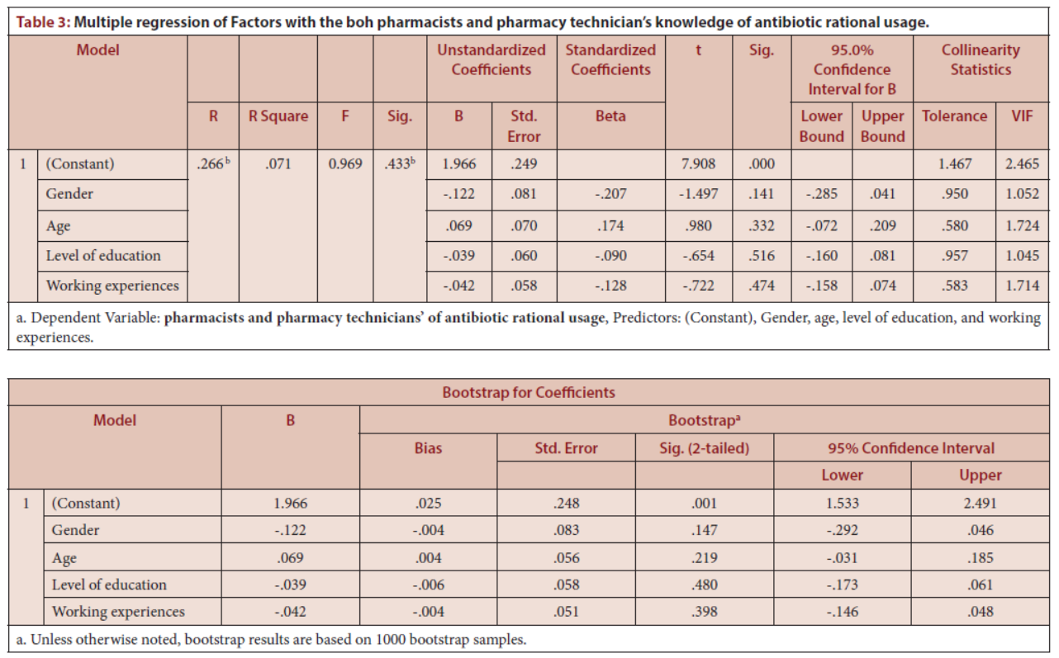

Slide 6
A more rigorous approach is needed to enhance the pharmacist’s and pharmacy technician’s knowledge of antibiotics to prevent the incidence of antimicrobial resistance. Further work in local PHCs, including rural areas, required identifying the awareness about antibiotics among pharmacy staff and exploring the inappropriate prescribing of antibiotics. Furthermore, targeting interventions such as implementing an antimicrobial stewardship program at PHC emphasizes educating and training medical staff, including pharmacy services workforces, about antibiotics and the risk of antimicrobial resistance is highly recommended.

