Slide 1
The Clinical Outcomes of Pharmacist Interventions at Critical Care Services of Private Hospital in Riyadh City, Saudi Arabia
Yousef Ahmed Alomi, Manal El-Bahnasawi,
Mohammed Kamran, Tasneen Shaweesh,
Soha Alhaj, Reem Ahmed Radwan

Slide 2
Objective: Dr. Sulaiman Al-Habib Medical Group (HMG) of Hospitals is one of the largest private chains of hospitals in the Kingdom of Saudi Arabia. At HMG, the clinical pharmacy services were started in 2015 which provides services to the acute and chronic cases of neonates, pediatrics and adults. In this study, we aimed to explore the clinical and economic outcomes of providing clinical pharmacy services at critical care units at a private hospital in Riyadh City, Saudi Arabia.
Methods: This was a 6-month cross-sectional study conducted from January to June 2016 at the critical care unit of HMG involving adult patients. The critical care unit has 30 beds dedicated to the treatment of trauma, medical, surgical and maternity patients. The clinical pharmacist monitors all patients through daily medical rounds and documents any intervention that needs to be provided to the patient. The pharmacist intervention system utilized an international study model, a measure of the level of activity, rational of clinical intervention, recommendation and patient outcome.

Slide 3
Results: A total number of 1222 pharmacist interventions were provided to 1124 adult patients. The highest number of critical care interventions were found to be potentially significant (610 (49.9%)) followed by potentially serious (360 (29.5%)) and neutral (249 (20.4%)) cases. Anti-infective medications (185 (25.9%)) were the most category of intervention provided followed by cardiovascular medications (96 (13.5%)) and gastro-intestinal medications (73 (10.2%)). The documented rationale of clinical intervention activities was others (203 (28.7%)), inappropriate dose (122 (17.3%)) and therapeutic duplication ((99 (14%)). Most of the patient outcomes were unknown (539 (44.1%)) followed by patient condition improved (408 (33.4%)) and therapeutic endpoint reached (133 (10.9%)).
Conclusion: The clinical pharmacy services at critical care units of a private hospital is a significant and essential component for patients care. The clinical pharmacist prevents the occurrence of drug-related problems in addition to saving additional economic burden on the healthcare system at HMG in the Kingdom of Saudi Arabia.

Slide 4
KEYWORDS
Clinical outcomes,
Pharmacist,
Interventions,
Critical care services,
Private hospital,
Riyadh,
Saudi Arabia.

Slide 5
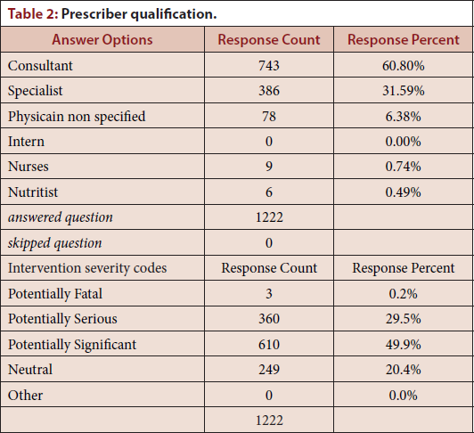

Slide 6
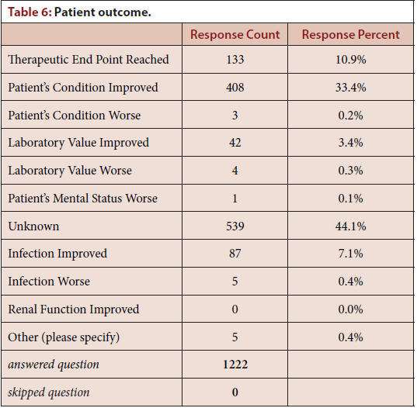

Slide 7
The critical care clinical pharmacist has a vital role in acute patient care. The pharmacist decreases drug-related morbidity and improves patient outcome at a private hospital. Expanding critical care clinical pharmacy services is required for all private healthcare institutions in the KSA.

