Slide 1
National Survey of Medication Safety Practice: Patient Education, Quality Process and Risk Management at Primary Healthcare Centers/Community Pharmacies in Riyadh, Saudi Arabia
Yousef Ahmed Alomi, Zainab Abdulmunem Almuallem, Manar Mohammed Alslim, Khulud Abdulrahman Alamoudi, Adel Mehmas H. Alragas, Rana Mohammed Alslim

Slide 2
Objective: To explore the national medication safety practice such as patient education, quality process and risk management at primary healthcare centers (PHCs) and community pharmacies (CPs) in Riyadh city, Kingdom of Saudi Arabia.
Methods: This is a four-month cross-sectional medication safety practice survey conducted at PHC pharmacies and CPs in Riyadh city. The survey consisted of the modified version of the Medication Safety Self-Assessment® for Community/Ambulatory Pharmacy from the Institute of Safe Medication Practice (ISMP). The survey consisted of a demographic section and 10 domains with 198 questions. The domains included questions on patient information; drug information; communication of drug orders and other drug information; drug labeling and packaging and nomenclature; use of devices; environmental factors; staff competency and education; patient education; quality processes; and risk management domain. In this study, we emphasized on patient education, quality process and risk management; it is a finding from medication safety self-assessment for community/ambulatory pharmacy in Riyadh city.

Slide 3
Results: The survey was distributed to 13 PHC pharmacies and 23 CPs. The average score of all ISMP-self assessment of medication safety items at PHCs was 2.75±0.36 (54.94%) (95% confidence interval (95% CI)=2.55–2.95; P<0.05; range=2.04–3.38). The average score of all ISMP-self assessment of medication safety items at CPs was 3.14±0.42 (62.86%) (95% CI=2.90–4.38; P<0.05; range=2.40–3.88). The average score of patient education at PHCs was 3.04±0.365 (60.8%) (95% CI=2.89–3.19; P<0.05; range=2.00–3.73) and at CPs, it was 3.73±0.29 (74.6%) (95% CI=3.61–3.85; P<0.05; range=3.11–4.22). The average score of quality processes and risk management at PHCs was 2.76±0.35 (55.2 %) (95% CI=2.64–2.88; P<0.05; range=2.09–3.50) and at CPs, it was 3.20 ±0.38 (64%) (95% CI=3.07–3.33; P<0.05; range=2.47–3.89). .
Conclusion: The implementation of patient education and quality processes and risk management at PHCs and CPs were inadequate. Targeting to improve all meditations safety assessment tools at PHCs and CPs is highly recommended in the Kingdom of Saudi Arabia.

Slide 4
KEYWORDS
Medication,
Safety,
Education,
Quality,
Risk Management,
Primary Healthcare Centers,
Community Pharmacies,
Riyadh,
Saudi Arabia.

Slide 5
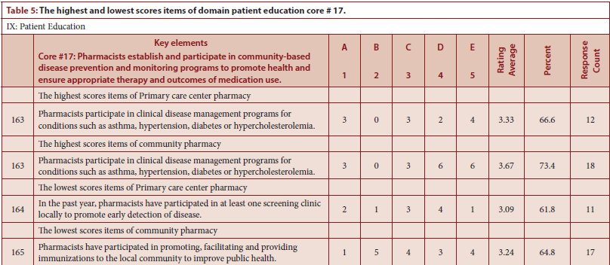

Slide 6
Half of medication safety assessments tool with emphasis on the patient counseling and quality management and risk management is not implemented in the PHCs and CPs. Several medication safety tools should be implemented with emphasis on e-prescribing, patient education, risk managements.

