Slide 1
Cardiovascular Medication Therapy During the Holy Month of Ramadan: A Literature Review
Yousef Ahmed Alomi

Slide 2
Objectives: To review cardiovascular medication therapy during the Holy month of Ramadan.
Methods: In this study, we performed an extensive search of 50 databases through the Saudi Digital Library search engine. We included meta-analysis, randomized controlled studies and observational studies published in English language in May 2017. The search terms included Ramadan, fasting, medication, therapy, type of disease and medication based on therapeutic class. The list of cardiovascular medications and switch from regular days to Ramadan days based on literature revealed that’s included comparative safety studies, efficacy and cost of type of medication for each disease studies and national or international evidence-based guidelines of switching short half-life to long half-life. All parenteral dosage form of medication were excluded from this study. All medications should be listed in the Ministry of Health drug formulary.

Slide 3
Results: A total of 710 studies were obtained after an extensive search with specific terms. Of those, 104 studies were duplicate studies and 606 studies were included for further evaluation. The evaluation revealed that there were 30 studies published on cardiovascular medications and Ramadan. Seven studies were further evaluated. The authors recommend to have a list of cardiovascular medications that can be switched from regular days to Ramadan days.
Conclusion: There were very studies about cardiovascular medications use during the holy month of Ramadan. Suggested usage of the frequency administration single or twice daily is required during fasting. Future investigations of cardiovascular medication intake during Ramadan is highly recommended in Muslim countries.

Slide 4
KEYWORDS
Cardiovascular,
Medication,
Therapy,
Review.

Slide 5
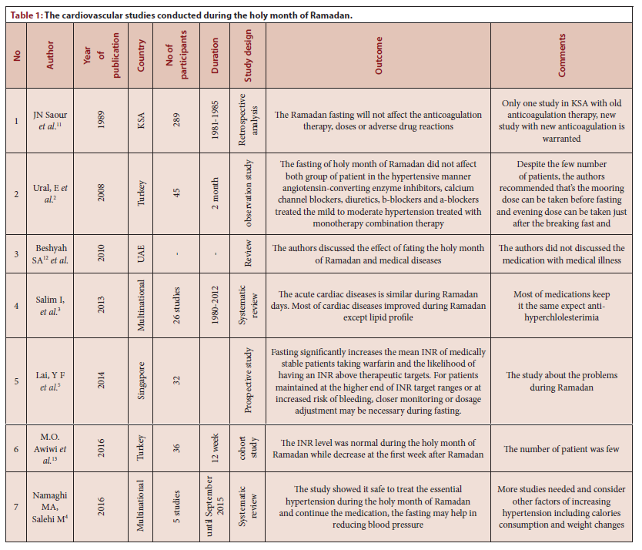

Slide 6
The cardiovascular medications intake may breakfast the holy month of Ramadan. Suggested the cardiovascular medication switch therapy from regular days to Ramadan days is highly recommended. All cardiovascular medication need submission individual studies about the medication during fasting during official country registration. Further studies of cardiovascular medication intake during the holy month of Ramadan is highly suggested in Muslim countries.

