Slide 1
Antimicrobial Drug Consumption in Emergency Services at North West (Tabuk) Region Hospitals, Saudi Arabia
Yousef Ahmed Alomi, Abeer Hussin Almasoudi, Ghormallah Abdullah Alghamdi, Nora Ali Abboud

Slide 2
Objectives: This article describes antimicrobial medication use among different age groups and the cost associated with it in emergency department at Northern West (Tabuk) hospitals, Saudi Arabia. The aim of this study to declare the antimicrobial medication use in emergency Units at North West Region Hospitals, Ministry of Health, Saudi Arabia.
Methods: It is a 12-month antimicrobial drug consumption by emergency services at North West region hospitals. It included all adults, pediatrics and neonatal population. The medications were selected by Central Antibiotics committee at MOH as part of the National Antimicrobial Stewardship program. The consumption is driven from pharmacy database and calculated based on off stranded unit of antimicrobial per hospital. The cost of antibiotics consumption was calculated by using Ministry of Health National Cost database. All cost used was as US currency.

Slide 3
Results: The total number of Antimicrobial standard units at Emergency departments were (8,805.00) with average (1,761.00) per hospital. The highest general drug consumption was Azithromycin PO 200 mg/15 ml (4253) and Ceftriaxone IV 1 g (805) and Gentamicin IV 80 mg (401) at Emergency departments. The total cost of antimicrobial consumption was (24,822.60 USD) and (4,964.52 USD) per hospital. The highest cost medication consumption from Adults Emergency departments was 59.85% (24,822.60 USD) followed by pediatrics Emergency departments 28.99% (7,197.03 USD) and Neonates Emergency departments of 11.16% (2,769.98 USD). The highest medication cost was for very broad-spectrum antibiotics like Meropenem IV, Azithromycin PO and Moxifloxacin IV. It consumed more than 60 % of the cost burden.
Conclusion: The Emergency department had a high consumption of antimicrobial drugs with burden cost. Antimicrobial stewardship program at Emergency services are necessary to prevent bugs related resistance, improve patient outcome and avoid necessary additional economic burden on healthcare system in the Kingdom of Saudi Arabia.

Slide 4
KEYWORDS
Antimicrobial,
Consumption,
Emergency,
Services,
North West (Tabuk),
Hospitals,
Saudi Arabia.

Slide 5
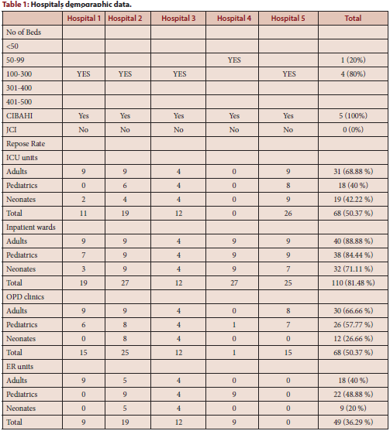

Slide 6
The antibiotic consumption at Emergency services is high. Targeting of antibiotic stewardship program is necessary at North West region hospitals in the Kingdom of Saudi Arabia. Further studies about annual antibiotic consumption and utilization are highly recommended in Saudi Arabia.

