Slide 1
Analysis of Antimicrobial Medication Consumption in Intensive Care Unit, North West (Tabuk) Region Hospitals, Saudi Arabia
Yousef Ahmed Alomi, Abeer Hussin Almasoudi, Ghormallah Abdullah Alghamdi, Samira Ali Asiri

Slide 2
Objectives: This article describes antimicrobial medication use among different age groups and the cost associated with it in intensive care units at North West (Tabuk) hospitals, Saudi Arabia. The aim of this study to explore the antimicrobial medication use in intensive care units at North West Region Hospitals, Ministry of Health, Saudi Arabia.
Methods: It is a 12-month antimicrobial drug use by intensive care units at North West region hospitals which included critical care for adults, pediatrics and neonates. The medications selected by Central Antibiotics committee at MOH as part of the National Antimicrobial Stewardship program. The consumption was driven from pharmacy database and calculated based on off standard unit of antimicrobials per hospital. The antimicrobials consisted of antibacterial drugs, antifungal and antiviral medications. The cost of antimicrobial consumption was calculated by using the Ministry of Health National Cost database. All cost used were as US currency.

Slide 3
Results: The total number of antimicrobial standard units were (14,305) and average (2,861) per hospital. The highest drug consumption was Ceftriaxone 1 gm injection (2724) followed by Imipenem 500 mg injection (1251) and Vancomycin 500 injection (1165). The total cost of Antimicrobial consumption was (53,884.95 USD) and (10,777 USD) per each hospital. The highest cost medication consumption from Adults critical care 73.42% (39,562.33 USD) followed by pediatrics critical care 18.15% (9,779.93 USD) and Neonates critical care 8.43% (4,542.68 USD). The highest medication cost was very broad-spectrum antibiotics like Meropenem, Imipenem and Ceftriaxone. It consumed more than 50% of the cost burden.
Conclusion: This study is the first in Saudi Arabia, Gulf and Middle East countries. Health system pharmacist leaders are targeting to implement the antimicrobial stewardship program and National Drug Utilization Evaluation system to control unnecessary medication expenditure and prevent misuse of medicines.

Slide 4
KEYWORDS
Patient,
Knowledge,
Medications,
Ministry of Health,
Saudi Arabia.

Slide 5
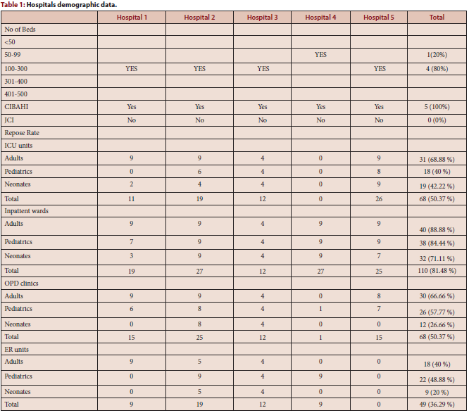

Slide 6
The broad-spectrum antibiotics are highly used in the critical care services in the North West region, Saudi Arabia. Annual studies of antibiotics consumption and utilization are highly recommended. The antibiotic stewardship program is required in the kingdom of Saudi Arabia

