Slide 1
Factors of Pharmacy Practice on Pharmacy Technician Job Satisfaction in Saudi Arabia
Yousef Ahmed Alomi, Faiz A. Bahadig Rph,
Bayan Ibrahim Alghuraybi, Budoor Emad Aloumi,
Reem Saad Alsubaie

Slide 2
Purpose: To explore the Pharmacy practice factors on pharmacy technician job satisfaction in Saudi Arabia.
Methods: It is a 4-months cross-section survey of the stress factors impact of pharmacy technician job satisfaction in Saudi Arabia. The study consisted of 35 questions divided into two-part demographic information and the second part consisted of three parts. Part one was about stress-related factors of pharmacy job. It included pharmacy management policies, pharmacy stress factors, pharmacy personal time, salary and benefits, pharmacy motivation factors. Part two included the questions about pharmacy services units of pharmacy job. It included pharmacy management structure, dispersing and patient education, clinical pharmacy services, pharmacy technology, pharmacy store and overall job satisfaction. Part three questions consisted of communication and relationships factors of pharmacy technician job. It included pharmacy supervisors, relationship with coworkers and pharmacist interaction with other healthcare providers, customer interaction and overall job satisfaction. The questionnaire was made as an electronic format and it analyzed through survey monkey system about part one about pharmacy services units of pharmacy technician job.

Slide 3
Results: The total responders were 96. The gender distribution 83 (86.46%) were males and 13 (13.54%) were females. The majority of them 86 (89.58%) were in age group (20-39 years). The average pharmacy technician satisfaction score of pharmacy management structure was (3.14), clinical pharmacy technician activities was (3.16), pharmacy technician satisfaction of pharmacy informatics was (2.76), pharmacy technician satisfaction score of pharmacy store factors were (2.87) and the overall job satisfaction was (3.62). The finding showed for factor there are no significant differences between male or female and social status married or single, experiences of current position and the most of salary income for all pharmacy services elements satisfaction (p>0.5).
Conclusion: The pharmacy services with an emphasis on information technology and pharmacy inventory management affected negatively to the pharmacy technician job satisfaction. All pharmacy services satisfactions should be corrected to improve the pharmacy technician in the Kingdom of Saudi Arabia.

Slide 4
KEYWORDS
Pharmacy,
Practice,
Factors,
Pharmacy Technicians,
Job,
Satisfaction,
Saudi Arabia.

Slide 5
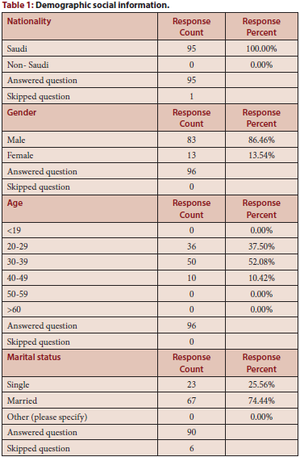

Slide 6
Pharmacy technician’s job satisfaction was affected negatively with absent of clinical pharmacy services, patient counseling services and pharmacy informatics. Targeting of corrections of pharmacy services affected positively the pharmacy technician’s job satisfaction in the Kingdom of Saudi Arabia.

