Slide 1
Evaluation of Oral Hygiene Practice, Knowledge and Attitude among (10-15 Yrs) School Children in Dharan, Nepal- A Cross Sectional Study
Roshana Poudyal, Priyata Agrawal, Ashish Shrestha, Mamta Dali, Tarakant Bhagat, Asish Choudhary

Slide 2
Background: The study is aimed to evaluate oral hygiene practice, knowledge and attitude among (10-15 yr) school children in Dharan. Materials and Methods: This is a cross sectional study which included 200 school students of age group (10-15 years) from five different schools of Dharan. The school and the students were selected by random sampling method. The consent for the participation of school children were obtained from the head of the school verbally. A pretested close- ended questionnaire was used for the study which was adopted from different conducted research. The questions were in English language.

Slide 3
Results: The result of this study show that only 15% of the students knew that gum bleeding means gingivitis. 83% reported that use of fluoride strengthens teeth and 81% knew that healthy teeth is strong and caries free teeth. 64.5% participant reported the reason for dental visit was general dental check up while 36% visited dentist only when dental pain and 76% felt the necessity of regular dental visit. 96% of the respondents used toothbrush and toothpaste as their brushing material and 83% of them brushed twice a day. Among all the students surveyed 80.5% had the habit of rinsing their mouth after eating. Results of this study prove that oral hygiene habits, oral health awareness and knowledge level among school children in Dharan is satisfactory. The participants had conducive oral health behavior, sufficient knowledge, positive attitude and practice regarding oral health.

Slide 4
KEYWORDS
Attitude,
Awareness,
Knowledge,
Oral hygiene,
Practice.

Slide 5
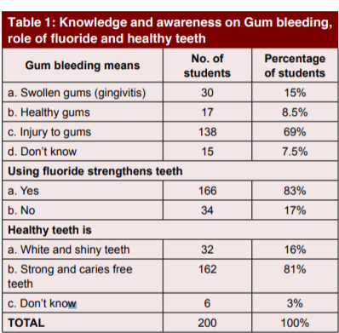

Slide 6
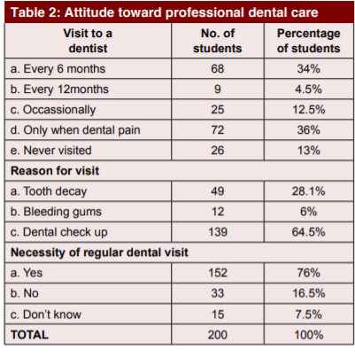

Slide 7
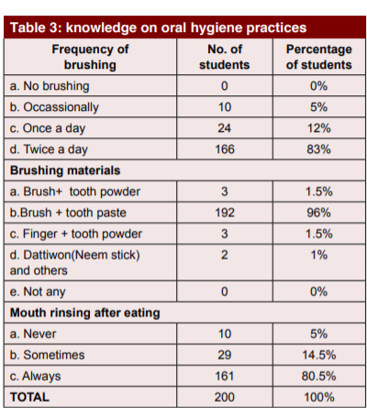

Slide 8
Results of this study prove that oral hygiene habits, oral health awareness and knowledge level among school children in Dharan is satisfactory. The participants had conducive oral health behavior, sufficient knowledge, positive attitude and practice regarding oral health. The information given to the parents and teachers, the role the media played in raising awareness helped the children to change their attitude and practice. The findings of this study suggested that the 10-15 years age group students would be the appropriate target group to receive the first organized intervention leading towards improving their oral health and reducing prevalence of dental disease.

