Slide 1
Phenytoin induced Stevens Johnson Syndrome: A Case Report
Upinder Kaur, Manish Bansal, Ajit Kumar, Sankha Shubhra Chakrabarti, Dinesh Kumar, Bl Pandey

Slide 2
Stevens Johnson syndrome (SJS) is a disastrous consequence of hypersensitivity reaction precipitated by certain drugs and viral infections. Among the drugs, antiepileptics, non-steroidal anti-inflammatory compounds and antibiotics are commonly implicated in the pathogenesis of SJS, although the overall incidence of this entity is very low. The syndrome is characterized by purpuricmacules and bullous eruptions involving the mucous membrane which may be followed by systemic manifestations. The disease may be lethal if undiagnosed and untreated. Age of the patient, area of involvement, nutrition status and presence of co-morbidites are the important determining factors of prognosis.

Slide 3
Septicemia and gastro intestinal bleeding are the lethal complications seen to develop if the disease remains untreated. Though not universal, but HLAB*1502 allele has been linked with phenytoin induced SJS in certain populations. Despite years of research, mechanism of SJS is not fully defined. Immune dysfunction mediated by T lymphocytes in response to phenytoin and oxidative stress generated by phenytoin are thought to be responsible. Here we present a case of SJS induced by phenytoin in an adult female. The case warrants the need of adopting a meticulous approach while prescribing phenytoin, especially in females who are at increased risk of developing drug related dermatological adverse effects.

Slide 4
KEYWORDS
Stevens Johnson syndrome,
Phenytoin,
Anti-epileptics,
Pharmacovigilance.

Slide 5
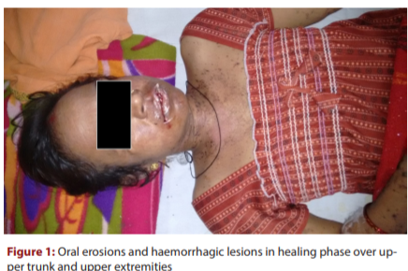

Slide 6
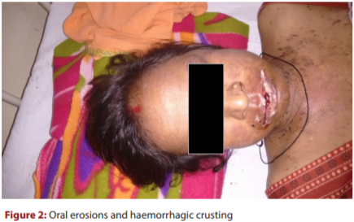

Slide 7
