Slide 1
In silico Screening of Thiazolidine 4-one Derivatives for Antitumor Activity
Palayyan Muralidharan, Gejalakshmi Subramaniam

Slide 2
Objective: To evaluate the potent histone deacetylase inhibitory activity of thiazolidine 4-one derivatives using Molegro virtual docker 6.0 version.
Methods: Chromone derivatives were drawn using ACD Chem Sketch software, Histone deacetylase a well-known tumor inhibitor is chosen as standard. Insilco docking studies were carried out using Molegro virtual docker version 6.0.

Slide 3
Results: Docking results showed all the selected Ligands has binding energy ranging between 40.36 kcal/mol to-47.67kcal/ mol when compared with that of standard which has binding energy 40.42.
Conclusion: Thiazolidone derivatives reported best histone deacetylase inhibitory activity because of its structural parameters. Further study on thiazolidine-4-one derivatives and in vivo and in vitro study are necessary to develop target moieties for treatment of tumor.

Slide 4
KEYWORDS
Binding affinity,
Histone deacetylase,
Thiazolidine 4-one,
Molegro virtual docker,
Thiazolidone.

Slide 5
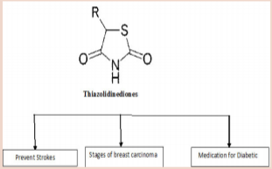

Slide 6
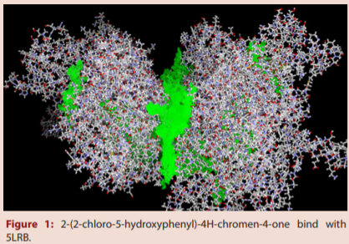

Slide 7
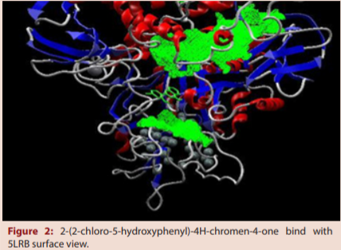

Slide 8
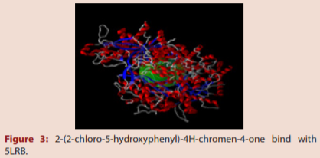

Slide 9
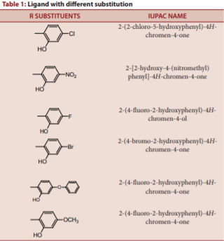

Slide 10
By using computational approaches derivatives designed showed good interactions with this atone deacetylase protein. 2-(4-fluoro2-hydroxyphenyl)-4H-chromen-4-one- 200.575 kcal/mol against 5LRB (PDB ID) in docking analysis. Docking studies confirm that the main interaction of IVWI inhibitors with enzyme is Hydrogen bond and Hydrophobic interactions with the binding pockets made by OH group of chromones and aromatic aldehyde substitution of the ligands. This information has potential implications to understand the mechanism of IVWI related enzymatic inhibition reactions, and applicable in the prediction of more effective inhibitors and engineering 3D structures of other enzymes as well.
So, it is concluded that that 2-(4-fluoro-2-hydroxyphenyl)-4H-chromen4-one,2-(4-hydroxy-2-hydroxyphenyl)-4H-chromen-4-one, 2-(4-chloro-2-hydroxyphenyl)-4H-chromen-4-ol could be a potent anti-tumor target molecule against IVWI which may be worth for further clinical trials. In this study, computations on the interactions at the active site of one were carried out for Six Ligands. In future, it may be necessary to explore the development of potential new histone deacetylase inhibitors for treating cancer. The present study shall help in rational drug design and synthesis of new selective histone deacetylase inhibitors with predetermined affinity and activity and provides valuable information for the understanding of interactions between 5LRB and the novel 4-hydroxy chromones.

