Slide 1
Isolation of Lactobacillus sp. from Intestinal Tract of Red Jungle Fowl as an Effective Probiotic for Poultry
S Santhosh, R Ranjith Kumar and R Dhandapani

Slide 2
Objective: : The present study focuses on the use of Lactobacillus sp. as probiotics to the Red jungle fowl and to test its growth efficacy.
Methods: : The isolated colonies were optimized at different pH range and it was found that at pH 7 maximum O.D value of 0.725 was attained and that of Temperature optimization at 30°C showed a maximum O.D value at 0.624 when read at 600 nm. The optimized pH and temperature were used for the mass production of Lactobacillus sp. for 3 days in orbital shaker and the biomass. The Biomass was fed to one month grown red jungle fowls , the biomass was mixed with commercial feed and the weight of the fowls were checked every 4 days interval to a total of 28 days

Slide 3
Results: A total of five colonies were isolated from the serial dilution performed on the nutrient agar medium and then it was streaked on MRS a specific medium for Lactobacillus sp. The isolated Lactobacillus sp. was given as a probiotic to the two test fowls and the weight of the fowls was 295 g on the 4th day and which increased gradually to 595 g on the 28th day. This shows that bacteria could be used as a probiotic to enhance the weight and quality of the chickens.

Slide 4
KEYWORDS
Lacto bacillus,
Optimization,
Fowls,
Probiotic,
Biomass.

Slide 5
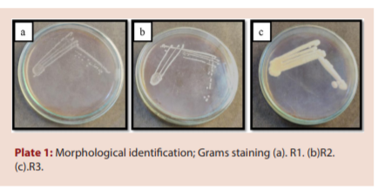

Slide 6
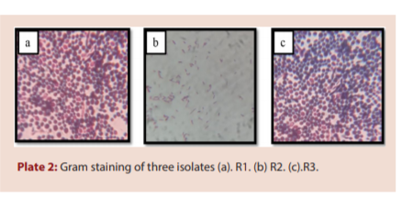

Slide 7
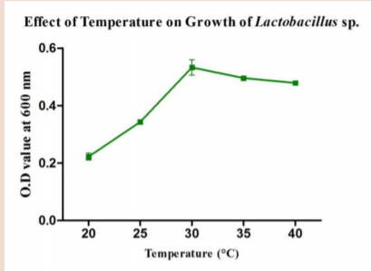
Figure 1: Effect of temperature on growth of strain R2.

Slide 8
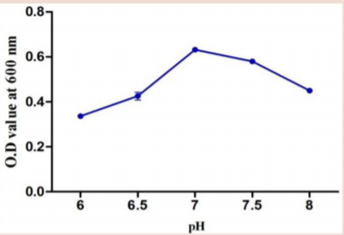
Figure 2: Effect of pH on growth of strain R2.

Slide 9
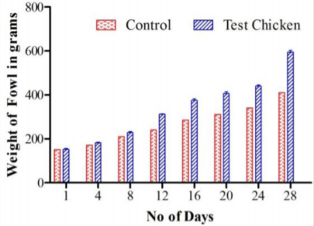
Figure 3: Effect of Lactobacillus sp. as a probiotic on the growth of Red jungle Fowls.

Slide 10
The isolated Lacto bacillus bacteria isolated from the digestive tract of the red jungle fowls gave promising results in the growth study performed. The results reveal that this bacterium can serve as a probiotic to chicken for their better growth and nourishment. The sensory valuation, quality of meat and other factors will be tested in the future study.

