Slide 1
Analysis of Gabapentinoids Abuse-Reports in the Middle East and North Africa Region Utilizing the Food and Drug Administration Adverse Event Reporting System
Mona Yaser Alsheikh, Ali Mofleh Alshahrani, Reem Dhayan Almutairi, Hana Abdulmohsen Althobaiti, Enrique Seoane-Vazquez, Moudi Mubarak Alasmari

Slide 2
Objectives: The purpose of this study was to identify abuse-related post-marketing reports associated with gabapentinoids use in the Middle East and North Africa (MENA) region countries.
Methods: A retrospective cross-sectional analysis of abuse-related adverse drug event (ADE) reports from the Middle East and North Africa (MENA) region. It was performed using the Food and Drug Administration Adverse Event Reporting System (FAERS) database from January 2008 through June 2020. Abuserelated ADE reports for gabapentin and pregabalin were extracted from the FAERS database. Descriptive statistics were performed, and the proportional reporting ratio (PRR) was calculated to detect disproportional attribution of abuse-related ADEs for gabapentin versus pregabalin.

Slide 3
Results: We identified 559 all-cause ADE reports for gabapentinoids, including 205 (36.7%) abuse-related ADE reports reported to FAERS in the period of analysis. FAERS included 139 (67.8%) pregabalin and 66 (32.2%) gabapentin abuse-related ADE reports. Among MENA region countries, Turkey (55, 39.6%) and Saudi Arabia (34, 23.7%) had the highest number of abuse-related ADE reports for pregabalin. The most pregabalin abuse-related ADE reports involved adult male patients. The PRR of pregabalin versus gabapentin abuse-related ADE reports was 1.11, indicating that the number of abuse-related events was higher for pregabalin compared to gabapentin.
Conclusion: Over 200 cases of abuserelated gabapentinoids events were reported to FEARS from the MENA region in the study period. Further studies should assess risk factors and potential programs to reduce gabapentinoids abuse.

Slide 4
KEYWORDS
Gabapentin,
Pregabalin,
Adverse drug events,
MENA,
FAERS,
Abuse.

Slide 5
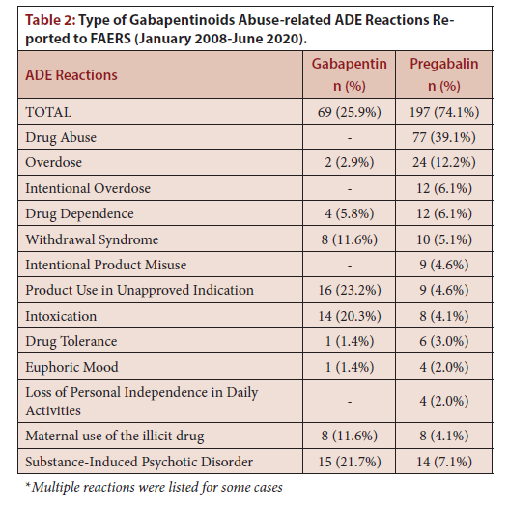

Slide 6
Over 200 cases of abuse-related gabapentinoids events were reported to FEARS from the MENA region in the study period. Further studies should assess risk factors and potential programs to reduce gabapentinoids abuse.

