Slide 1
Perception of Pharmacists about Scientific Publications in Saudi Arabia
Yousef Ahmed Alomi, Sultan Mohammed Al-Jarallah, Juman saad Mohammad Alsaab, Razan Alshehri, Khawla Ibrahim Al-shahrani

Slide 2
Objectives: In this study, we aimed to explore the perception of pharmacists about scientific publications in the Kingdom of Saudi Arabia.
Methods: This is a cross-sectional study conducted to explore the perception of pharmacists about scientific publications in Saudi Arabia. We used a selfreported electronic survey questionnaire and distributed it to interns to consultants, and pharmacy specialists in Saudi Arabia. The survey collected demographic information of the responders, their perception of scientific publications, and barriers preventing them from participating in pharmacy scientific publications. In addition, we requested their suggestions on how to stimulate their interest in pharmacy publications. We used 5-point Likert response scale system with close-ended questions to obtain responses. The data were collected through the Survey Monkey system and analyzed with the Statistical Package of Social Sciences (SPSS), Jeffery’s Amazing Statistics Program (JASP), and Microsoft Excel (version 16) software.

Slide 3
Results: The average score for the perception of pharmacists about scientific publications was 3.74. The highest score (3.33) was obtained for the element “the pharmacist understands the pharmacy publication and pharmacy publications terminology.” The score for the element “pharmacist believes that pharmacy publications are essential for the pharmacist” was (3.97). According to our results, the pharmacists are interested in working on a pharmacy publications project. The average score for the barriers that prevent pharmacists from participating in pharmacy scientific publication was (3.76). The high score for the element “the pharmacist believes that the daily activities prevent me from doing pharmacy publication as there is lack of interest and motivation” was 3.88. The score for the element “pharmacist considers that pharmacy publications are essential for the pharmacist” was (3.85). The average score for the element “suggestions to stimulate interest in pharmacy publications” was (3.40). The highest score was obtained for the element “the pharmacist believes that teaching undergraduate students about pharmacy publications should be an integral part of the practice” was (3.68). The score for “creating awareness about pharmacy practice-based pharmacy publications and benefits to practice” was (3.58). The score for the single-test reliability analysis of McDonald’s ω was (0.905), Cronbach’s α was (0.908), Gutmann’s λ2 was (0.923), Gutmann’s λ6 was (0.981), and greater lower bound was (0.993).

Slide 4
Conclusion: The perception of pharmacists about scientific publication was found to be inadequate to fair. Therefore, removing the obstacles such as high workload and encouraging pharmacy staff to publish should improve the perception of performance publications in Saudi Arabia.

Slide 5
KEYWORDS
Perception,
Pharmacists,
Scientific,
Publications Saudi Arabia.

Slide 6
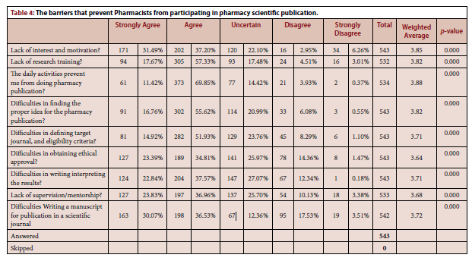

Slide 7
The perception of pharmacists about scientific publications was positive. However, the perception of barriers preventing scientific publications stimulation elements of scientific publications was fair. In addition, various factors affected the perception of scientific publications, such as higher age, more experience, and higher positions, which negatively affected the results. However, other factors such as location, gender, and nationality varied. Therefore, clinical and administrative support for scientific publications and implementation programs will improve pharmacy scientific publications’ perception in Saudi Arabia.

