Slide 1
Cost Analysis of Combined Emergency and Outpatient Pharmacy Services in the Kingdom of Saudi Arabia
Mona Yaser Alsheikh, Asma Saqer Alamri,
Raghad Abdulaziz Alasmari, Bandar Awwadh Alosaimi,
Yousef Ahmed Alomi

Slide 2
Objectives: In this study, we aimed to declare the cost of combined outpatient and emergency pharmacy services in the Kingdom of Saudi Arabia.
Methods: This is a cross-sectional questionnairebased study. We used an electronic survey with a judgment sampling system to obtain responses. The structured questionnaire consisted of two parts written in English and Arabic. The first part collected demographic information of the responders based on multiple-choice questions. The second part contains questions for measuring the personal cost, overhead cost for the place, and the equipment used for pharmaceutical services in the combined outpatient and emergency pharmacy, the cost of purchased materials and supplies, and non-salary cost. All costs used US dollar currency. The data were collected through the SurveyMonkey system and analyzed via Microsoft Excel version 2020.

Slide 3
Results: The total of judgment responders was nine directors of pharmacy. For more than six years, most pharmacy directors had experience in an emergency pharmacy, outpatient pharmacy, and pharmacy administration. A total of 100–199 occupational beds were present (33.33%), followed by <50 beds (22.22%) and 400–499 beds (22.22%). The total daily cost of combined OPD pharmacy and emergency services was (2336.01) USD, whereas the daily cost of OPD pharmacy was (1424.97) USD. Therefore, the daily cost of emergency pharmacy services was (911.04) USD. The majority of the daily cost for combined OPD pharmacy and emergency services came from personal cost of (1526.68) USD (65.35%) and overhead cost of (695.39) USD (29.77%). The cost of preparation and dispensing at OPD pharmacy was (13.32) USD, which is the average cost per medication dispensed from OPD pharmacy. In comparison, the preparation and dispensing cost at the emergency pharmacy was 5.2 USD, the average cost per medication.
Conclusion: This study explored the cost analysis of combined OPD and emergency pharmacy services. Therefore, we highly recommend reducing the daily cost of pharmacy services needed to implement new ambulatory care and emergency activities or Saudi Managed Care Pharmacy in the Kingdom of Saudi Arabia.

Slide 4
KEYWORDS
Cost,
Combined,
Emergency,
Outpatient,
Pharmacy,
Kingdom of Saudi Arabia.

Slide 5
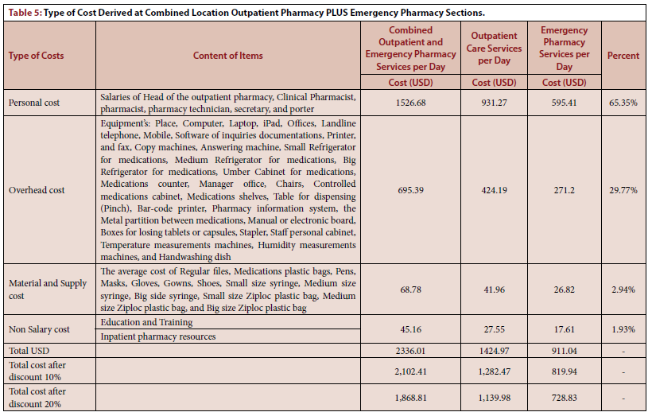

Slide 6
In conclusion, further research is highly warranted to monitor the cost of pharmacy services in the KSA. Therefore, the services delivered to the patients and the reimbursement cost must be specified for Saudi Managed Care Pharmacy (Wasfaty) in KSA.

