Slide 1
Pharmacy Infection Control: Pharmacoepidemiology and infection control surveillance
Yousef Ahmed Alomi, Anhar Alyousef, Mohammed Mominul Islam, Nahed Rashid Alyami, Maha Hussein Almadany, Fatimah Abdaziz Almana

Slide 2
Objectives: Pharmacoepidemiology and infection control surveillance is an initiative that provides insights into pharmacy infection control. It involves various guidelines and policies that must be followed to ensure the pharmacy environment and workplace are secured from infections. Different approaches have been considered for the measures to be effective. Documentation of pharmacy practices in every area of the pharmacy department is vital in controlling the pharmacy infections. This study aimed to explore the pharmacoepidemiology and infection control surveillance policy in pharmacy practice as a new initiative in Saudi Arabia.

Slide 3
Methods: It is a narrative review of pharmacoepidemiology and infection control surveillance pharmacy practice. Litterateur searched. A literature search was performed using various databases, including PubMed, Medline, and Google Scholar, about specific pharmacy practice infection control policies and procedures. The search period was from the 1960s until October 2021. The terms were in English and included narrative review, systemic review, metaanalysis, and guidelines across all hospitals and community pharmacy services. Moreover, the national and international guidelines of were searched that relates to the study objectives. The committee of pharmacy research formulated and consisted of various experts, including clinical pharmacists, drug information pharmacists, and infection control specialists. Some authors drafted the policy guidelines, and others reviewed and corrected them. The additional author, an infection control specialist, revised the final document. The study emphasizes the pharmacoepidemiology and infection control surveillance of the Pharmacy infection control policy. Results: The Pharmacoepidemiology and infection control surveillance policy consisted of pharmacoepidemiology and infection control surveillance steps in pharmacy practice. The pharmacoepidemiology and infection control surveillance contained multiple performances: infected prepared medications, type of bugs, and sensitivity patterns to medications. In addition to the number of spillage cleaning and needle-stick injuries, the number of cross-tarnsmission of infections. Besides, the search also included adherence to infection control guidelines.

Slide 4
Conclusion: Pharmacoepidemiology and infection control surveillance policy is a new pharmacy infection prevention and control initiative. The pharmacoepidemiology and infection control surveillance policy enhances the infection control documentation system. Additionally, it encourages pharmacists to follow infection prevention and control regulations in various locations throughout the public and healthcare systems. Therefore, pharmacoepidemiology and infection control surveillance policies strongly recommend Saudi Arabian pharmacy pratices.

Slide 5
KEYWORDS
Pharmacy,
Infection,
Control,
Pharmacoepidemiology,
Surveillance.

Slide 6
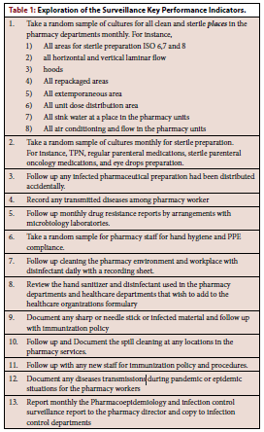

Slide 7
The policy is a new pharmacy infection prevention and control initiative that improves the infection control documentation system. It also encourages pharmacists to adhere to infection prevention and control regulations in places such as the public and healthcare organizations. Its components include drug-resistant surveillance, incidents of contaminated pharmaceutical preparations, and pharmacy workers’ occupational safety. Furthermore, the monitoring of infection control standards compliance manipulates suggestions and regulations. Therefore, Pharmacoepidemiology and infection control surveillance are especially advised to be implemented in pharmacy infection and prevention operations in Saudi Arabia.

