Slide 1
Levetiracetam-Induced Urination and Urinary Frequency in Pediatrics. A Case Report
Manar Bayounis. M.D, Nouf Al-Assadi

Slide 2
Objectives: Levetiracetam (LEV) is a broad-spectrum antiepileptic drug used in children and adults. The use of LEV is associated with behavioral abnormalities as adverse drug reactions. However, it might increase the frequency of urination as an adverse effect, which has not been observed or reported previously in Saudi Arabia. It is a description of the unusual side effects of levetiracetam.
Methodology: A case report of three patients aged 6, 5 and 6 years, respectively. They were diagnosed with epilepsy and treated with levetiracetam. After LEV treatment, all three cases experienced increased urinary frequency and incontinence.

Slide 3
Results: The Naranjo Adverse Drug Reaction Probability Scale was applied on the three cases and was found to be possibly related in two cases to LEV therapy and probably related in one. We reduced the dose in one patient, and the side effects improved to half. Moreover, it was resolved after discontinuation of the medication. In the other two cases, the side effect resolved on its own. It was reported in the literature that 2 cases had urinary frequency after starting on levetiracetam and improved after reducing the dose and switching to other medication. Conclusion: LEV might induce an increase in the frequency of urination. It was an under-reported issue and should be addressed as a transient adverse drug reaction effect. However, it can strongly affect compliance with medication. Therefore, clinicians should be attentive and look exclusively for this symptom to educate the families during follow-up visits.

Slide 4
KEYWORDS
Levetiracetam,
Urinary frequency,
Urgency,
Daytime incontinence,
Adverse drug reaction.

Slide 5
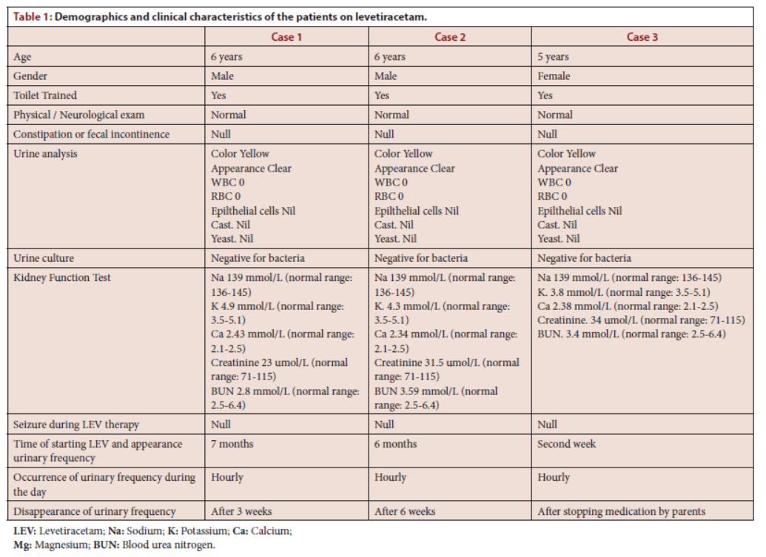

Slide 6
Based on the observations in the three case reports (post-marketing experience), LEV may cause a transient increase in the frequency of urination and a diurnal effect in children. Except for some case reports, it has not been documented as a known adverse effect.

