Slide 1
National Survey of Medication Safety Practice: Medication Administration at Primary Healthcare Centers/Community Pharmacies in Riyadh, Saudi Arabia
Yousef Ahmed Alomi, Adel Mehmas Hamdi Alragas, Manar Mohammed Alslim, Khulud Abdulrahman Alamoudi, Zainab Abdulmunem Almuallem, Rana Mohammed Alslim

Slide 2
Objective: To explore the national medication safety practice with emphasis on medication administration at primary healthcare centers (PHCs) and community pharmacies (CPs) in Riyadh city, Kingdom of Saudi Arabia.
Methods: This is a four-month cross-sectional medication safety practice survey conducted at PHC pharmacies and CPs in Riyadh city. The survey consisted of the modified version of the Medication Safety Self-Assessment® for Community/Ambulatory Pharmacy from the Institute of Safe Medication Practice (ISMP). The survey consisted of a demographic section and 10 domains with 198 questions. The domains included questions on patient information; drug information; communication of drug orders and other drug information; drug labeling and packaging and nomenclature; use of devices; environmental factors; staff competency and education; patient education; quality processes; and risk management domain. In this study, we emphasized on medication administration; it is a finding from medication safety self-assessment for community/ambulatory pharmacy in Riyadh city.

Slide 3
Results: The survey was distributed to 13 PHC pharmacies and 23 CPs. The average score of all ISMP-self assessment items of medication safety at PHCs was 2.75±0.36 (54.94%) (95% CI=2.55– 2.95; P<0.05; range=2.04–3.38). The average score of all ISMP-self assessment items of medication safety at CPs was 3.14±0.42 (62.86%) (95% CI=2.90–4.38; P<0.05; range=2.40–3.88). The average score of drug standardization, storage and distribution domain at PHCs was 2.35±0.41 (47%) (95% CI=2.17–2.53; P<0.05; range=1.33–3.09) and in CPs, it was 3.4±0.54 (68%) (95% CI =3.16–3.54; P<0.05; range=2.22–4.25). The average score of medication devices acquisition, use and monitoring domain at PHCs was 3.62±0.14 (72.4%) (95% CI=3.26–3.978; P<0.05; range=3.45–3.70) and in CPs, it was 2.78±0.23 (55.6%) (95% CI=2.21–3.349; P<0.05; range=2.63-3.05).
Conclusion: The medication administration safety was inadequate at PHCs while acceptable at CPs. Targeting to drug standardization, storage and distribution with emphasis on medication devices use and monitoring are highly recommended at PHCs in the Kingdom of Saudi Arabia.

Slide 4
KEYWORDS
Medication,
Safety,
Administration,
Primary care centers,
Community pharmacy,
Riyadh,
Saudi Arabia.

Slide 5
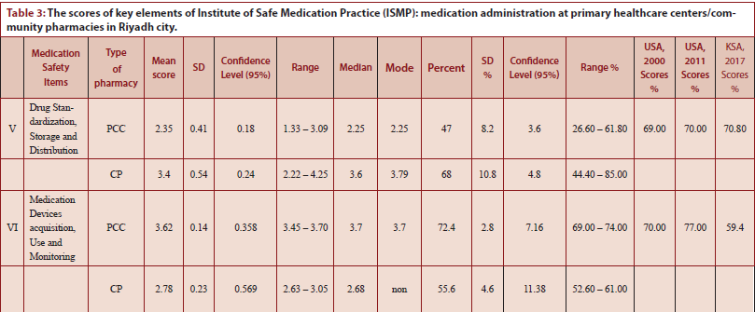

Slide 6
