Slide 1
Pattern use of Non-steroidal Anti-inflammatory Drugs among Saudi Community: Patients’ Perspective
Amani Abdullah Bahdailah

Slide 2
Objectives: In this study, we aimed to explore the utilization of public use of non-steroidal anti-inflammatory drugs (NSAIDs) among the participants from the major metropolitan areas in Saudi Arabia.
Methodology: This is a cross-sectional study conducted over a period of 6 months. The study questionnaire was randomly distributed via digital media using Survey Monkey system to individuals in the Kingdom of Saudi Arabia. The questionnaire comprised 24 questions related to demographic data; age; education; socioeconomic status; weight; history of chronic disease; history of pain; frequency, type and dosage of NSAIDs; and indication for the use of NSAIDs. The survey web link was distributed via social media to a convenient sample of participants. Data were tabulated and analyzed by using SPSS version 13 software.

Slide 3
Results: The survey questionnaire was distributed to 3000 patients and a total of 500 participants responded, making the response rate as 16.6%. Of them, the highest percentage of responders belonged to the age group of above 40 years (52.63%, n=263). Majority of the responders had a university degree (66.20%, n=329). Of all the responders, 54% (n=272) did not use painkillers daily, whereas 43.33% (n=216) took painkillers daily; 2.26% (n=11) of the responders did not remember. Around 87% (n=433) of the responders tool an average of 1–3 NSAIDs daily, 11.44% (n=57) took 4–7 NSAIDs daily and 1.49% (n=7) responders took 8–12 NSAIDs daily without a prescription. Furthermore, 0.50% (n=2) of the responders took more than 12 NSAIDs per day.
Conclusion: The NSAIDs are highly utilized in the Kingdom of Saudi Arabia. Therefore, the number of awareness programs for the public about the side effects of short- and long-term use of NSAIDs is highly recommended in Saudi Arabia.

Slide 4
KEYWORDS
Pattern,
Use,
Non-steroidal Anti-inflammatory Drugs,
Patient,
Saudi Arabia.

Slide 5
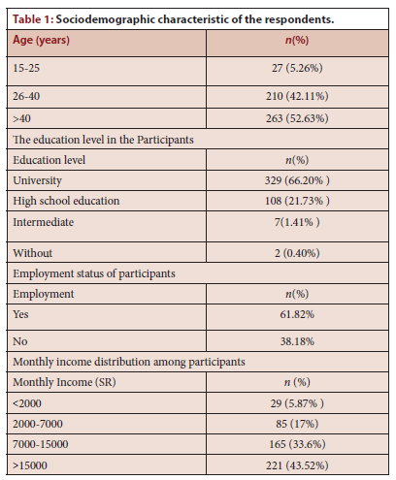

Slide 6
There was a high utilization of Non-Steroidal Anti Inflammatory with Saudi population. Targeting of public awareness campaigns about the appropriate usage the medications. Future studies may be conducted to measure the impact of education program for the usage of Non-Steroidal Anti Inflammatory in the Kingdom of Saudi Arabia.

