Slide 1
Analysis of Antimicrobial Medications Consumption in Inpatient Units at North West (Tabuk) Region Hospitals, Saudi Arabia
Abeer Hussin Almasoudi, Yousef Ahmed Alomi, Ghormallah Abdullah Alghamdi, Rasha Saad Alshahrani

Slide 2
Background: This article aims to explore antimicrobial medication consumption and related cost among different age groups in inpatient units at North West Region Hospitals, Ministry of Health, and Saudi Arabia.
Objectives: To explore the selected antimicrobial medication consumption in inpatient units at North West Region Hospitals, Ministry of Health, Saudi Arabia. To increase the awareness of antimicrobial medication consumption side effect.
Methods: It is a 9-month study about antimicrobial drug use by inpatients at North West region hospitals. It included inpatient department for adults, pediatrics and neonates. The medications were selected by Central Antibiotics committee at MOH as part of the National Antimicrobial Stewardship program. The consumption is driven from pharmacy database and calculated based on off-stranded unit of antimicrobial per hospital. The antimicrobials consisted of antibacterial drugs, antifungal and antiviral medications. The cost of antimicrobial consumption was calculated by using Ministry of Health National Cost database. All cost used as US currency.

Slide 3
Results: The total number of Antimicrobial standard units was (25,845) and average (5,169) per hospital. The highest drug consumption was Ceftriaxone 1 gm injection (3,712) followed by Ceftazidime 1 gm injection (1807) and Gentamicin IV 80 mg (1,011) at adult’s inpatient wards. The total cost of Antimicrobial consumption was (6,829,003.42 USD) and (1,365,800.68 USD) per hospital. The highest cost medication consumption from Adults inpatient departments was 99.62% (6,803,229.92 USD) followed by pediatrics inpatient 0.24% (16,087.6 USD) and Neonatal inpatient departments 0.14% (9,685.9 USD). The highest medication cost was for very broad-spectrum antibiotics like Meropenem, Imipenem and Ceftriaxone. It consumed more than 50% of the cost burden.
Conclusion: There was very high consumption of antimicrobial drugs inpatient department with huge cost burden. Urgent application of antimicrobial stewardship program especially adults’ inpatients departments is a mandate and urgent.

Slide 4
KEYWORDS
Antimicrobial,
Medications,
Consumption,
Inpatient,
North West (Tabuk),
Hospitals,
Ministry of Health,
Saudi Arabia.

Slide 5
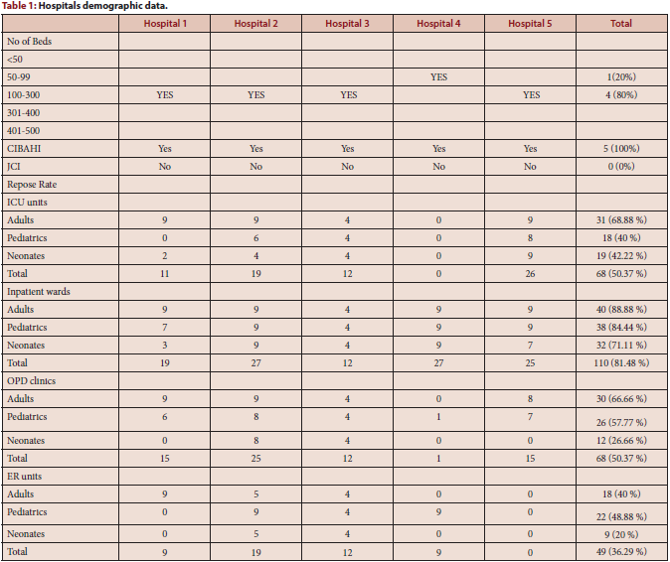

Slide 6
The broad-spectrum antibiotics are highly used in the inpatient services at North West region in the Kingdom of Saudi Arabia. Targeting of implantation of Antibiotic stewardship program at inpatient services. Moreover, further studies about antibiotic utilization in such detail is required in the North West region of Saudi Arabia.

