Slide 1
Dental Drug Information Websites Resources: New Initiative Project in Saudi Arabia
Yousef Ahmed Alomi, Hanin Sumaydan Saleam Aljohani,
Arub Abdullah Batil Albatil

Slide 2
Objectives: All healthcare professionals necessity to improve and update their medical and pharmaceutical knowledge, including dentists. There are numerous types of dental medications, including drug information website resources. The current review is to reconnoiter references websites of medications in the dental care.
Methods: It is a literature review of a drug information website for dentists. Probing was done in PubMed and Medline about this field. The search encompassed all study designs but was not limited to the observation study, clinical trial, meta-analysis and systemic, and review articles. The current topic debated the market assessment demand, team and cost management of the project, quality and risk management of the project. It was rationalized on selected dental drug websites designed with medications coverage, frequency updated, and responsible publisher.

Slide 3
Results: More than 13 drug information websites for dental practice had been intended. The websites consisted of free governmental or healthcare organizations websites highlighting international medications regulation or local drug regulatory affairs with mobile applications format. Free non-governmental drug information website entailed of drug therapy as part of disease management and other medication patient education websites. All websites of dental drug information resources should be measured undergraduate and postgraduate dental practitioners.
Conclusion: Dental drug information resources website is real-world and more accessible than other resources. Therefore, implementation of the current project is highly recommended for dental colleges and healthcare organizations.

Slide 4
KEYWORDS
Dental,
Drug,
Information,
Websites,
Resources,
Saudi Arabia.

Slide 5
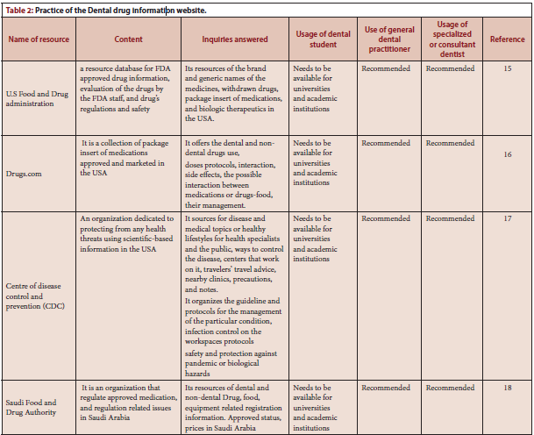

Slide 6
There are numerous dental medications information website references accessible for all dentist specialties. The majority of those references are free of deviations and more reachable than other resources. Reconnoitering the collection of dental drug websites can measure the dentist professionals to apply it in the dental field. The current project desires the dental team to apprise the website regularly and deliver education and training for dental providers. Moreover, the team can support the dental staff’s logistics and financially the new project operation. Further studies is required to update the newest drug information references website and keep the dentists reorganized about the latest dental drug websites.

