Slide 1
Cost Analysis of Neonatal Drug Distribution Services at Ministry of Health in Saudi Arabia
Yousef Ahmed Alomi, Malika Alhadab, Tahani Alotaibi, Awatif Faraj Alshammari, Nouf Alhaze

Slide 2
Objectives: The cost estimation of delivery of drug therapy management (unit dose, floor stock and discharge) for neonatal inpatient is a part of the pharmacoeconomic program and changing the system to the Saudi vision 2030 at MOH in Saudi Arabia. The study explored the cost calculations of delivery of drug therapy services for neonate’s population by using American Model with local cost.
Methods: It is cross-sectional 6-months analysis of drug distribution services for neonate patients conducted in 2016. It was at 300-Bed Maternity and Pediatrics Hospital in Riyadh, Saudi Arabia. The cost analysis consisted of three domains. Domain one; the cost of delivery of Adults drug therapy management with 144 beds. Domain two; the cost of delivery of pediatrics drug treatment services with 55 beds. Domain three; cost of delivery for neonate’s therapy services with 82 beds. For each domain, the physician prescribed the medications. The pharmacist reviewed and prepared drugs and distributed through unit dose system, floor stock distribution and discharge medications. The nurse administered drugs and followed up with doctors. The drugs were prepared through ASHP standards and facilities. The oral and topical ready to deliver drugs were included in the study while sterile product and compounding formulations were excluded from the study. The cost was derived from Ministry of Health information database. The cost model was calculated based on variable expenses including personal cost, material and supply cost. Fixed costs including direct cost, non-salary cost and overhead cost. All cost was used US dollar currency and local prices. This study analyses the three domains.

Slide 3
Results: The estimated daily cost of neonatal unit dose drug distribution system for all total pediatrics 82 beds was (1,303.31 US). It contained three types; the unit dose system (794.83 USD), drug floor stock distribution system (371.37 USD) and discharge medication system (137.11 USD). The cost of delivery of medicines to single bed per day was (41.64 USD) with highest estimated cost of delivery from discharge medication (27.42 USD), followed by unit dose services (9.69 USD) and floor stock therapy (4.53 USD). The majority of cost came from overhead cost in floor stock services and discharge medication delivery; while the personal cost in unit dose services delivery. The total estimated annual expenditures of drug distribution services were (475,708.15 USD).
Conclusion: The estimated cost of delivery of neonatal medication therapy is a part of the pharmacoeconomic program at pharmacy services and future vision 2030 in Saudi Arabia.

Slide 4
KEYWORDS
Cost,
Analysis,
Neonatal,
Drug,
Distribution,
Services,
Ministry of Health,
Saudi Arabia.

Slide 5
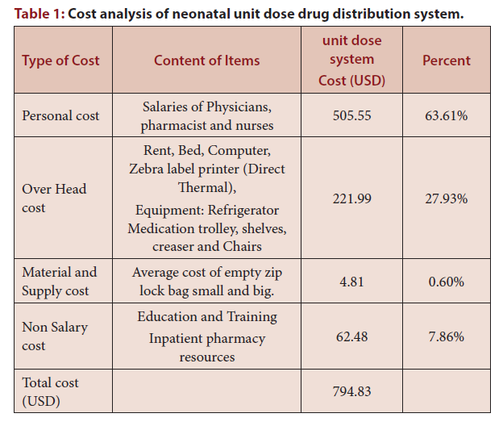

Slide 6
The estimated cost of delivery neonatal medication therapy is a part of the pharmacoeconomic program at pharmacy services and future vision 2030 in Saudi Arabia.

